Slide 1
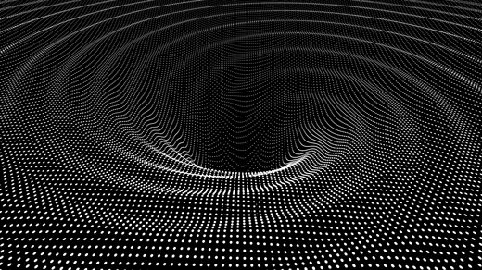
Semiclassical energy fluxes at the inner horizon of a rotating black hole
Noa Zilberman
Under the supervision of Prof. Amos Ori
Technion, Haifa, Israel
GR23 International Conference, Beijing, China
July 2022

Slide 2
This talk is based on the following papers:
Two-point function of a quantum scalar field in the interior region of a Kerr black hole,
NZ, M. Casals, A. Ori and A. C. Ottewill (arXiv:2203.07780)
Quantum fluxes at the inner horizon of a spinning black hole,
NZ, M. Casals, A. Ori and A. C. Ottewill (arXiv:2203.08502)
Related previous works in the spherical charged case
Analysis of quantum effects inside spherical charged black holes,
A. Lanir, A. Ori, NZ, O. Sela, A. Maline, A. Levi (Phys. Rev. D 99, 061502, 2019)
Quantum fluxes at the inner horizon of a spherical charged black hole,
NZ, A. Levi and A. Ori (Phys. Rev. Lett. 124, 171302, 2020)
Quantum fluxes at the inner horizon of a near-extremal spherical charged black hole, NZ and A. Ori (Phys. Rev. D 104, 024066, 2021)

Slide 3
Another universe
r=0
r=0
???
Inner horizon
Inner horizon
Cauchy horizon
Black hole
Event horizon
r=∞
Our universe
r=∞

Slide 4
In this talk:
Motivation and basic framework
Unruh quantum state
Mode contributions to the fluxes
Renormalization via state subtraction
Numerical results
Backreaction (preliminary) and summary

Slide 5
Motivation
Quantum effects modify spacetime geometry (e.g., Hawking)
Classical perturbations alter otherwise regular BH interiors
Cauchy horizon null weak singularity
Quantum perturbations: stronger singularity?
Recent results in the spherical charged case
Our goal: address this issue via concrete calculation in the rotating case.
Spinning: A. Ori (1992). Charged: A. Ori (1991).
E. Poisson and W. Israel (1990).
N. D. Birrell and P. C. W. Davies (1978).
W. A. Hiscock (1980).
A. C. Ottewill and E. Winstanley (2000).
A. Lanir, A. Ori, NZ, O. Sela, A. Maline, A. Levi (2019).
NZ, A. Levi and A. Ori (2020). NZ and A. Ori (2021).
S. Hollands, R. M. Wald and J. Zahn (2020).
S. Hollands, C. Klein and J. Zahn (2020).

Slide 6
Previous analytical works on the CH divergence
All worked with conservation equation, showing only indications for CH divergence in 4d, via a non-vanishing $T_{vv}$.
N. D. Birrell and P. C. W. Davies, 1978:
RN, conformally coupled scalar field, quantum state: HH, showed divergence on CH in 2d, indications for divergence on CH in 4d
W. A. Hiscock, 1980.
Kerr-Newman, quantum state: Unruh, showed divergence on at least one of the IH sections (outgoing and\or ingoing), not conclusive whether it is the CH.
A. C. Ottewill and E. Winstanley, 2000.
Kerr, variety of quantum states (including Unruh), agrees with Hiscock (1980) – gives conditions for divergence and shows it has to happen on at least on of the IH and on one of the EH.

Slide 7
The semi-classical formulation of GR
Quantum matter fields propagating on a classical curved spacetime
Semi-classical Einstein equation:
$$Φ$$
$$g_{αβ}$$
$$G_{αβ}=8π{\left\langle {\hat{T}}_{αβ}\right\rangle }_{ren}$$
Backreaction
A requirement for self consistency
First (challenging) step:
Compute the renormalized stress energy tensor on classical black hole backgrounds

Slide 8
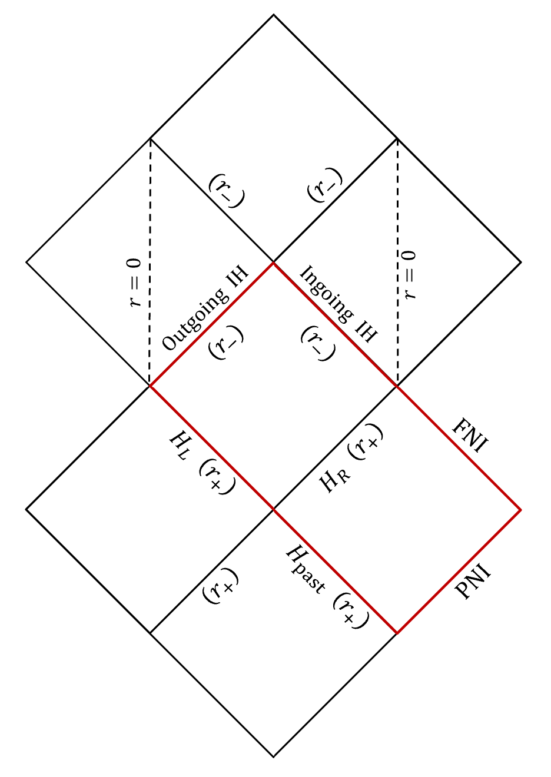
Kerr metric
$$r_{+}$$
$$r_{+}$$
$$r_{−}$$
Rotating, isolated black hole of mass $M$ and angular momentum per unit mass $a$
$$r_{−}$$
$$r=0$$
$$r=0$$
$$=−\left(1−\frac{2Mr}{ρ^{2}}\right)dt^{2}+\frac{ρ^{2}}{Δ}dr^{2}+ρ^{2}dθ^{2}+\left(r^{2}+a^{2}+\frac{2Mra^{2}}{ρ^{2}}\sin^{2}{θ}\right)\sin^{2}{θ}dφ^{2}−\frac{4Mra}{ρ^{2}}\sin^{2}{θ}dφdt$$
$$Δ≡r^{2}−2Mr+a^{2}, ρ^{2}≡r^{2}+a^{2}\cos^{2}{θ}$$
Event horizon (EH): $r_{+}=M+\sqrt{M^{2}−a^{2}}$
Inner horizon (IH): $r_{−}=M−\sqrt{M^{2}−a^{2}}$
$$r_{−}$$
$$r_{−}$$
$$ds^{2}$$
$$r_{+}$$
$$r_{+}$$
$$r=∞$$
CH
$$r=∞$$
$$r_{+}$$
$$r_{+}$$
Black hole interior
$$r_{−}$$
$$r_{−}$$
$$r=0$$
$$r=0$$
$$r_{−}$$
Exterior universe
$$r_{−}$$
$$Δ\left(r_{±}\right)=0$$
$$r_{+}$$
$$r_{+}$$
$$r=∞$$
$$r=∞$$
$$\left|a\right|/M$$
$$r_{+}$$
$$r_{+}$$
$$0$$
$$1$$
$$r_{−}$$
$$r_{−}$$
Schwarzschild
Extremal Kerr
Maximally extended, non-extremal Kerr BH

Slide 9
The field
Minimally-coupled massless scalar quantum field $\hat{Φ}$.
Klein-Gordon:
$$◻\hat{Φ}=0$$
covariant d’Alembertian
The Teukolsky equation: (on Kerr background)
$$=\left(\frac{{\left(r^{2}+a^{2}\right)}^{2}}{Δ}−a^{2}\sin^{2}{θ}\right)\frac{∂^{2}Φ}{∂t^{2}}+\frac{4aMr}{Δ}\frac{∂^{2}Φ}{∂t∂φ}+\left(\frac{a^{2}}{Δ}−\frac{1}{\sin^{2}{θ}}\right)\frac{∂^{2}Φ}{∂φ^{2}}−\frac{∂}{∂r}\left(\frac{∂Φ}{∂r}\right)−\frac{1}{\sin{θ}}\frac{∂}{∂θ}\left(\sin{θ}\frac{∂Φ}{∂θ}\right)=0$$
$$◻Φ$$

Slide 10
Field decomposition
$ω$: time translation frequency
$$Φ_{ωlm}\left(t,r,θ,φ\right)=N_{ωlm}\frac{ψ_{ωlm}\left(r\right)}{\sqrt{r^{2}+a^{2}}} e^{−iωt} Z_{lm}^{ω}\left(θ,φ\right)$$
temporal
angular
radial
$Z_{lm}^{ω}\left(θ,φ\right):$ spheroidal harmonics
$$Z_{lm}^{ω}\left(θ,φ\right)=\frac{1}{\sqrt{2π}}e^{imφ}S_{lm}^{ω}\left(θ\right)$$
Spheroidal eigenfunction
$$\frac{1}{\sin{θ}}\frac{d}{dθ}\left(\sin{θ}\frac{dS_{lm}^{ω}\left(θ\right)}{dθ}\right)+\left(a^{2}ω^{2}\cos^{2}{θ}−\frac{m^{2}}{\sin^{2}{θ}}+E_{lm}\left(aω\right)\right)S_{lm}^{ω}\left(θ\right)=0$$
Spheroidal eigenvalue

Slide 11
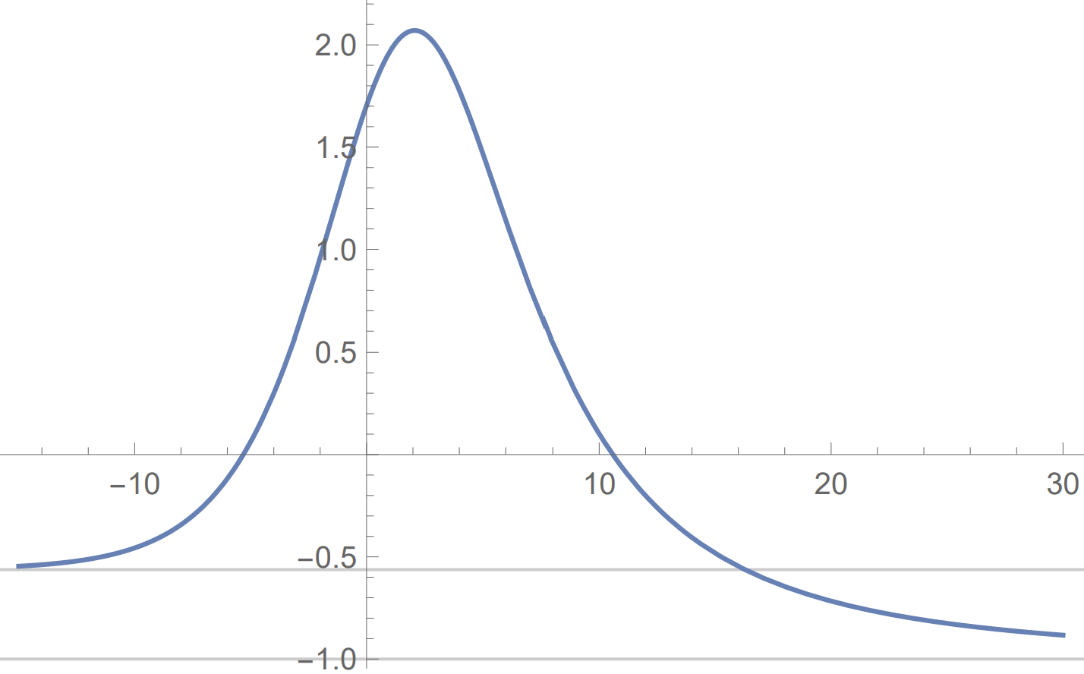
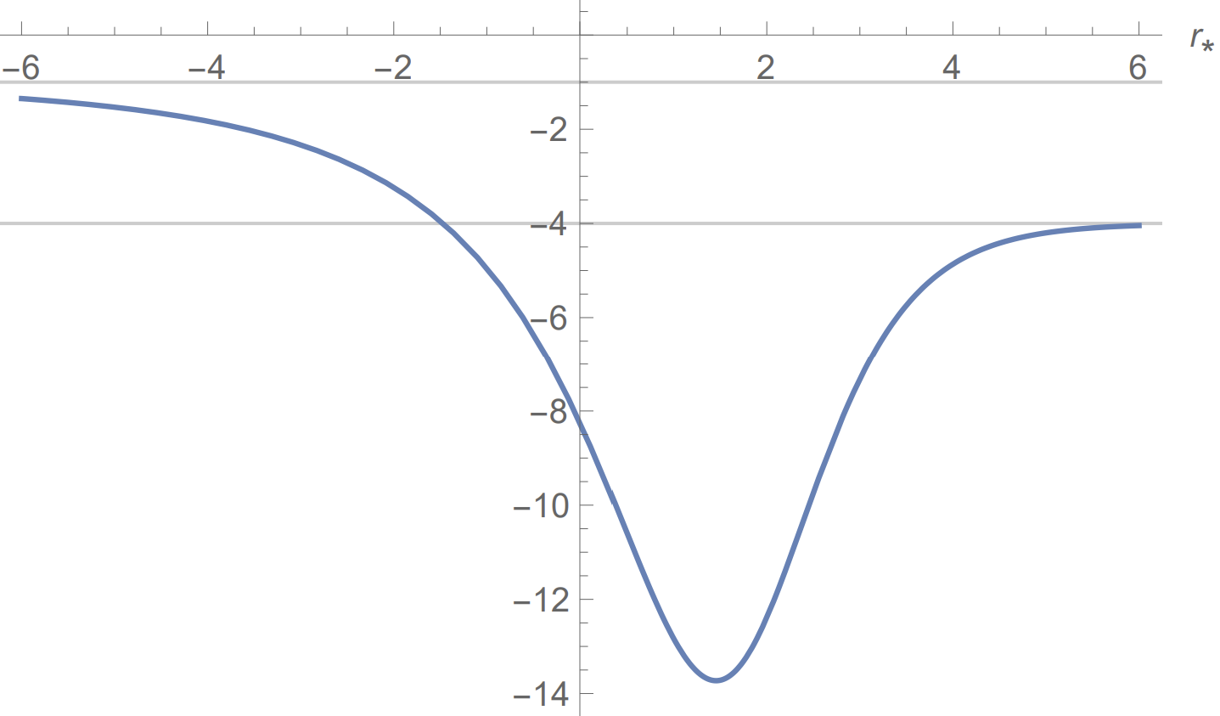
The radial equation
Outside:
$$\left(\frac{d^{2}}{dr_{∗}^{2}}+V_{ωlm}\left(r\right)\right)ψ_{ωlm}\left(r\right)=0$$
$${−V}_{ωlm}$$
$$r→r_{+}$$
$$r→∞$$
$$V_{ωlm}≅\left\{\begin{aligned}ω^{2}, r→∞ \\ ω_{+}^{2} , r→r_{+} \\ ω_{−}^{2} , r→r_{−}\end{aligned}\right.$$
$$r_{∗}$$
$$−ω_{+}^{2}$$
$$−ω^{2}$$
$$r→r_{+}$$
Inside:
$$r→r_{−}$$
$$−ω_{+}^{2}$$
$$r_{∗}$$
$$−ω_{−}^{2}$$
where $ω_{±}=ω−mΩ_{±}$
(reminder: $Ω_{±}=\frac{a}{2Mr_{±}}$)
$${−V}_{ωlm}$$

Slide 12
The effective potential
$$V_{ωlm}\left(r\right)=\frac{K_{ωm}^{2}\left(r\right)−λ_{lm}\left(aω\right)Δ}{{\left(r^{2}+a^{2}\right)}^{2}}−G^{2}\left(r\right)−\frac{dG\left(r\right)}{dr_{∗}}$$
$$K_{ωm}\left(r\right)=\left(r^{2}+a^{2}\right)ω−am$$
$$λ_{lm}\left(aω\right)=E_{lm}\left(aω\right)−2amω+a^{2}ω^{2}$$
$$G\left(r\right)=\frac{rΔ}{{\left(r^{2}+a^{2}\right)}^{2}}$$

Slide 13
In this talk:
Motivation and basic framework
Unruh quantum state
Mode contributions to the fluxes
Renormalization via state subtraction
Numerical results
Backreaction (preliminary) and summary

Slide 14
The field
Minimally-coupled massless scalar quantum field $\hat{Φ}$.
Klein-Gordon:
$$◻\hat{Φ}=0$$
covariant d’Alembertian
Vacuum quantum state
Unruh state: an evaporating black hole (Unruh, 1976)
(empty at past null infinity, outgoing flux of thermal radiation at future null infinity)

Slide 15
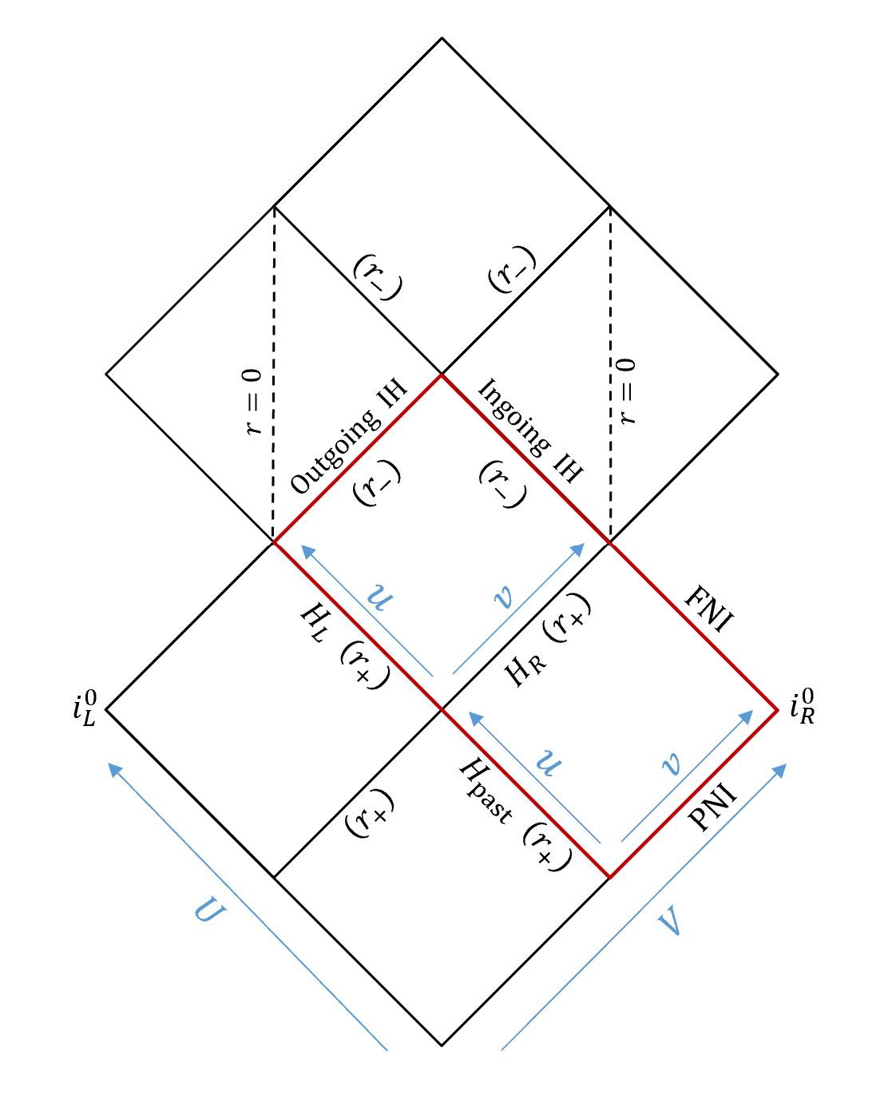
Decomposition in terms of Unruh modes:
$$\hat{Φ}\left(x\right)=\int_{0}^{∞}{dω\sum_{Λ,l,m}{g_{ωlm}^{Λ}\left(x\right){\hat{a}}_{ωlm}^{Λ}+g_{ωlm}^{Λ∗}\left(x\right){\hat{a}}_{ωlm}^{Λ\text{†}}}}$$
Unruh state:
$${\hat{a}}_{ωlm}^{Λ}{\left.|0\right\rangle }_{U}=0$$
$$Λ="up" or "in"$$
Boundary conditions:
$${(r}_{−})$$
$$Ingoing IH$$
$${(r}_{−})$$
$$Ingoing IH$$
Reminder on coordinates:
$$g_{ωlm}^{in}$$
$$g_{ωlm}^{up}$$
Eddington: $v=r_{∗}+t$
$$u=t−r_{∗} \left(outside\right)$$
$r_{∗}−t$ $(inside)$
Kruskal:
$$U\left(u\right)=−\frac{1}{κ_{+}}e^{−κ_{+}u} \left(outside\right)$$
$\frac{1}{κ_{+}}e^{κ_{+}u} (inside)$
$$Outgoing IH$$
$${(r}_{−})$$
$$Outgoing IH$$
$${(r}_{−})$$
$$H_{R} \left(r_{+}\right)$$
$$FNI$$
$$H_{L} \left(r_{+}\right)$$
$$H_{R} \left(r_{+}\right)$$
$$FNI$$
$$H_{L} \left(r_{+}\right)$$
Non separable!
$$e^{−i\hat{ω}U}$$
$$e^{−iωv}$$
$$H_{past} \left(r_{+}\right)$$
$$H_{past} \left(r_{+}\right)$$
$$PNI$$
$$PNI$$
For more details on the families of modes: N. Zilberman, M. Casals, A. Ori and A. C. Ottewill (arXiv:2203.07780)

Slide 16
Eddington modes: a mathematical tool
$$f_{ωlm}^{Λ}\left(t,r,θ,φ\right)=\frac{N_{ωlm}}{\sqrt{ r^{2}+a^{2}}}Z_{lm}^{ω}\left(θ,φ\right)e^{−iωt}ψ_{ωlm}^{Λ}(r)$$
- Separable
Exterior Eddington modes
Interior Eddington modes
$${(r}_{−})$$
$${(r}_{−})$$
$${(r}_{−})$$
$$Ingoing IH$$
$${(r}_{−})$$
$$Ingoing IH$$
$$Ingoing IH$$
$$f_{ωlm}^{up}$$
$$Ingoing IH$$
$$f_{ωlm}^{L}$$
$$f_{ωlm}^{in}$$
$$f_{ωlm}^{R}$$
$$Outgoing IH$$
$$Outgoing IH$$
$$Outgoing IH$$
$${(r}_{−})$$
$$Outgoing IH$$
$${(r}_{−})$$
$${(r}_{−})$$
Reminders:
$${(r}_{−})$$
Eddington coordinates:
$v=r_{∗}+t$
$$u=t−r_{∗} \left(outside\right)$$
$r_{∗}−t$ $(inside)$
$$ω_{±}=ω−mΩ_{±}$$
$$e^{iω_{+}u}$$
$$FNI$$
$$FNI$$
$$FNI$$
$$H_{R} \left(r_{+}\right)$$
$$e^{−iω_{+}v}$$
$$FNI$$
$$H_{L} \left(r_{+}\right)$$
$$H_{R} \left(r_{+}\right)$$
$$H_{L} \left(r_{+}\right)$$
$$H_{L} \left(r_{+}\right)$$
$$H_{R} \left(r_{+}\right)$$
$$H_{L} \left(r_{+}\right)$$
$$H_{R} \left(r_{+}\right)$$
$$ρ_{ωlm}^{up}$$
$$τ_{ωlm}^{up}$$
$$τ_{ωlm}^{in}$$
$$ρ_{ωlm}^{in}$$
$$e^{−iω_{+}u}$$
$$H_{past} \left(r_{+}\right)$$
$$H_{past} \left(r_{+}\right)$$
$$e^{−iωv}$$
$$H_{past} \left(r_{+}\right)$$
$$PNI$$
$$H_{past} \left(r_{+}\right)$$
$$PNI$$
$$PNI$$
$$PNI$$
For more details on the families of modes: N. Zilberman, M. Casals, A. Ori and A. C. Ottewill (arXiv:2203.07780)

Slide 17
In this talk:
Motivation and basic framework
Unruh quantum state
Mode contributions to the fluxes
Renormalization via state subtraction
Numerical results
Backreaction (preliminary) and summary

Slide 18
The bare (naïve) stress-energy tensor (in minimal coupling)
Classical starting point
$T_{μν}=Φ_{,μ}$ $Φ_{,ν}−\frac{1}{2}g_{μν}Φ_{,α}Φ^{,α}$
stress-energy tensor of a scalar field:
$𝒯_{μν}≡T_{μν}−\frac{1}{2}g_{μν}T_{α}^{α}=Φ_{,μ}$ $Φ_{,ν}$
Trace-reversed:
The quantum version (naïve)
$${\left\langle {\hat{𝒯}}_{μν}\right\rangle }_{bare}=\left\langle {\hat{Φ}}_{,μ}{\hat{Φ}}_{,ν}\right\rangle$$

Slide 19
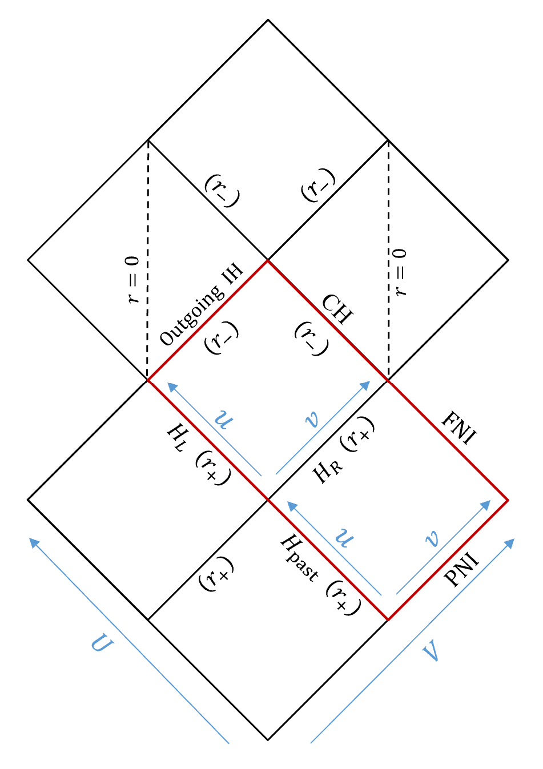
The flux components
Reminder on coordinates inside the BH:
Eddington:$v=r_{∗}+t, u=r_{∗}−t$ | Kruskal: $V\left(v\right)=\frac{1}{κ_{+}}e^{κ_{+}v}, U\left(u\right)=\frac{1}{κ_{+}}e^{κ_{+}u}$
$$T_{vv}$$
$$T_{uu}$$
Flux components: $T_{uu}$ and $T_{vv}$
- crucial for backreaction at the CH vicinity
Cauchy horizon
Energy-momentum conservation yields a
conserved quantity (independent of $r$)
$$\left(r^{2}+a^{2}\right)\left(T_{uu}\left(r,θ\right)−T_{vv}\left(r,θ\right)\right)$$
$$T_{uu}=0$$
Event horizon
In Unruh
$$T_{vv}<0$$
coincides with Hawking radiation outflux per unit solid angle

Slide 20
Bare flux expressions at the inner horizon
Trace-reversed stress-energy tensor:
$${\left\langle {\hat{𝒯}}_{μν}\right\rangle }_{bare}=\left\langle {\hat{Φ}}_{,μ}{\hat{Φ}}_{,ν}\right\rangle$$
$$T_{μν}≡𝒯_{μν}−\frac{1}{2}g_{μν}𝒯_{α}^{α}$$
Since $g_{uu}=g_{vv}=0$ at the inner horizon, the bare IH flux components:
$${\left\langle {\hat{T}}_{yy}^{−}\right\rangle }_{bare}=\left\langle {\hat{Φ}}_{,y}{\hat{Φ}}_{,y}\right\rangle$$
$$\left(r=r_{−}\right)$$
$y$ is either $u$ or $v$

Slide 21
Let’s focus on $T_{vv}$ (the other flux quantity, $T_{uu}$, differs by a regular, conserved quantity)
$${\left\langle {\hat{T}}_{vv}^{−}\right\rangle }_{bare}^{U}={\left\langle {\hat{Φ}}_{,v}{\hat{Φ}}_{,v}\right\rangle }^{U}$$
$$\left(r=r_{−}\right)$$
$$=ℏ\int_{0}^{∞}{dω\sum_{Λ,l,m}{g_{ωlm,v}^{Λ}g_{ωlm,v}^{Λ∗}}}$$
In terms of Unruh modes:
$$\left(r=r_{−}\right)$$
$$Λ="up" or "in"$$
$$=\int_{0}^{∞}{dω}\sum_{l,m}{ }\left(\frac{{\left(S_{lm}^{ω}\left(θ\right)\right)}^{2}}{8π^{2}\left(r_{−}^{2}+a^{2}\right)}\frac{ω_{−}^{2}}{ω_{+}}\left[\coth\left(\frac{{πω}_{+}}{κ_{+}}\right)\left({\left|A_{ωlm}\right|}^{2}+{\left|ρ_{ωlm}^{up}\right|}^{2}{\left|B_{ωlm}\right|}^{2}\right)+2 cosech\left(\frac{{πω}_{+}}{κ_{+}}\right)ℜ\left(ρ_{ωlm}^{up}A_{ωlm}B_{ωlm}\right)+\left(1−{\left|ρ_{ωlm}^{up}\right|}^{2}{\left|B_{ωlm}\right|}^{2}\right)\right]\right)$$
Each Unruh mode $g_{ωlm}^{Λ}$ may be written as a superposition of Eddington modes.
Reminder: $ω_{±}=ω−mΩ_{±}$
N. Zilberman, M. Casals, A. Ori and A. C. Ottewill (arXiv:2203.07780)

Slide 22
N. Zilberman, M. Casals, A. Ori and A. C. Ottewill (arXiv:2203.07780)
$${\left\langle {\hat{T}}_{vv}^{−}\right\rangle }_{bare}^{U}=\int_{0}^{∞}{dω}\sum_{l,m}{ }\left(\frac{{\left(S_{lm}^{ω}\left(θ\right)\right)}^{2}}{8π^{2}\left(r_{−}^{2}+a^{2}\right)}\frac{ω_{−}^{2}}{ω_{+}}\left[\coth\left(\frac{{πω}_{+}}{κ_{+}}\right)\left({\left|A_{ωlm}\right|}^{2}+{\left|ρ_{ωlm}^{up}\right|}^{2}{\left|B_{ωlm}\right|}^{2}\right)+2 cosech\left(\frac{{πω}_{+}}{κ_{+}}\right)ℜ\left(ρ_{ωlm}^{up}A_{ωlm}B_{ωlm}\right)+\left(1−{\left|ρ_{ωlm}^{up}\right|}^{2}{\left|B_{ωlm}\right|}^{2}\right)\right]\right)$$
$ρ_{ωlm}^{up}$ is the scattering coefficient for the “up” mode outside the BH:
$A_{ωlm}$ and $B_{ωlm}$ are coefficients of the free solution for $ψ_{ωlm}^{int}$ near the IH:
This expression contains all the required information - but the sum ( $\int_{0}^{∞}{dω}\sum_{l,m}{ }$) diverges.
$$ψ_{ωlm}^{up}≅\left\{\begin{aligned}e^{iω_{+}r_{∗}}+ρ_{ωlm}^{up}e^{−iω_{+}r_{∗}}, r→r_{+} \\ τ_{ωlm}^{up}e^{iωr_{∗}}, r→∞\end{aligned}\right.$$
$$ψ_{ωlm}^{int}≅\left\{\begin{aligned}e^{−iω_{+}r_{∗}}, r→r_{+} \\ A_{ωlm}e^{iω_{−}r_{∗}}+B_{ωlm}e^{−iω_{−}r_{∗}}, r→r_{−}\end{aligned}\right.$$

Slide 23
In this talk:
Motivation and basic framework
Unruh quantum state
Mode contributions to the fluxes
Renormalization via state subtraction
Numerical results
Backreaction (preliminary) and summary

Slide 24
Regularization in curved spacetime: Point-splitting
${\left\langle {\hat{Φ}}^{2}\right\rangle }_{ren}$: B. S. DeWitt, 1965
${\left\langle {\hat{T}}_{αβ}\right\rangle }_{ren}$: S. M. Christensen, 1976
Basic point-splitting:
$${\left\langle {\hat{Φ}}^{2}\left(x\right)\right\rangle }_{ren}=\lim_{x^{′}→x}\left[\left\langle \hat{Φ}\left(x\right)\hat{Φ}\left(x^{′}\right)\right\rangle −G_{DS}\left(x,x^{′}\right)\right]$$
Two-point function
$G_{DS}\left(x,x′\right)$: DeWitt-Schwinger counter term
$$G_{DS}\left(x,x^{′}\right)=\frac{ℏ}{4π^{2}s^{2}(x,x^{′})}$$
In our case (minimally-coupled, massless field in vacuum):
Depends on the geometry, not on the quantum state!
$s\left(x,x^{′}\right)$ is the invariant distance between the points

Slide 25
Renormalization by state subtraction
$${\left\langle {\hat{T}}_{μν}\right\rangle }_{ren}={\left\langle {\hat{T}}_{μν}\right\rangle }_{bare}−{\left\langle {\hat{T}}_{μν}\right\rangle }_{div}$$
The diverging quantity that needs to be subtracted
Purely geometric, shared by all quantum states
$${\left\langle {\hat{T}}_{μν}\right\rangle }_{ren}^{U}=\left({\left\langle {\hat{T}}_{μν}\right\rangle }_{bare}^{U}−{\left\langle {\hat{T}}_{μν}\right\rangle }_{bare}^{Q}\right)+{\left\langle {\hat{T}}_{μν}\right\rangle }_{ren}^{Q}$$
Regular
Useful if known
Regular
$U:$ Unruh state, $Q:$ some other quantum state

Slide 26
We now focus on the Unruh $T_{vv}$ flux component at the IH:
$${\left\langle {\hat{T}}_{vv}^{−}\right\rangle }_{ren}^{U}$$
$$=\left({\left\langle {\hat{T}}_{vv}^{−}\right\rangle }_{bare}^{U}−{\left\langle {\hat{T}}_{vv}^{−}\right\rangle }_{bare}^{Q}\right)+{\left\langle {\hat{T}}_{vv}^{−}\right\rangle }_{ren}^{Q}$$
Regular mode-sum
Want: $=0$
$${\left\langle {\hat{T}}_{vv}^{−}\right\rangle }_{bare}^{U}=\int_{0}^{∞}{dω}\sum_{l,m}{\left(\frac{{\left(S_{lm}^{ω}\left(θ\right)\right)}^{2}}{8π^{2}\left(r_{−}^{2}+a^{2}\right)}\frac{ω_{−}^{2}}{ω_{+}}\left[\coth\left(\frac{{πω}_{+}}{κ_{+}}\right)\left({\left|A_{ωlm}\right|}^{2}+{\left|ρ_{ωlm}^{up}\right|}^{2}{\left|B_{ωlm}\right|}^{2}\right)+2 cosech\left(\frac{{πω}_{+}}{κ_{+}}\right)ℜ\left(ρ_{ωlm}^{up}A_{ωlm}B_{ωlm}\right)+\left(1−{\left|ρ_{ωlm}^{up}\right|}^{2}{\left|B_{ωlm}\right|}^{2}\right)\right]\right)}$$
N. Zilberman, M. Casals, A. Ori and A. C. Ottewill (arXiv:2203.07780, arXiv:2203.08502)

Slide 27
Motivation for reference state: Unruh behavior at event horizon
We know: ${\left\langle {\hat{T}}_{uu}^{+}\right\rangle }_{ren}^{U}=0$ (regularity of Unruh state at EH)
$${\left\langle {\hat{T}}_{uu}^{+}\right\rangle }_{bare}^{U}=\int_{0}^{∞}{dω}\sum_{l,m}{ \left[\frac{{\left(S_{lm}^{ω}\left(θ\right)\right)}^{2}}{8π^{2}\left(r_{+}^{2}+a^{2}\right)}ω_{+}\coth\left(\frac{{πω}_{+}}{κ_{+}}\right)\right]}$$
N. Zilberman, M. Casals, A. Ori and A. C. Ottewill (arXiv:2203.07780)
Can we construct a quantum state $\underline{U}$ such that
${\left\langle {\hat{T}}_{vv}^{−}\right\rangle }_{ren}^{\underline{U}}=0$?

Slide 28
The negative mass universe
The form of the metric stays the same
$$ds^{2}=−\left(1−\frac{2Mr}{ρ^{2}}\right)dt^{2}+\frac{ρ^{2}}{Δ}dr^{2}+ρ^{2}dθ^{2}+\left(r^{2}+a^{2}+\frac{2Mra^{2}}{ρ^{2}}\sin^{2}{θ}\right)\sin^{2}{θ}dφ^{2}−\frac{4Mra}{ρ^{2}}\sin^{2}{θ}dφdt$$
$$ds^{2}=−\left(1−\frac{2\overline{M}\overline{r}}{{\overline{ρ}}^{2}}\right)dt^{2}+\frac{{\overline{ρ}}^{2}}{\overline{Δ}}d{\overline{r}}^{2}+{\overline{ρ}}^{2}dθ^{2}+\left({\overline{r}}^{2}+a^{2}+\frac{2\overline{M}\overline{r}a^{2}}{{\overline{ρ}}^{2}}\sin^{2}{θ}\right)\sin^{2}{θ}dφ^{2}−\frac{4\overline{M}\overline{r}a}{{\overline{ρ}}^{2}}\sin^{2}{θ}dφdt$$
Metric extends through ring singularity to negative r values
$$r=r_{+}$$
$$r=r_{+}$$
$$r=∞$$
$$\overline{IH}$$
$$\overline{IH}$$
$$r=∞$$
$$r=−∞$$
$$\overline{H_{L}}$$
$$\overline{EH}$$
$$r=−∞$$
$$r=r_{−}$$
$$r=r_{−}$$
$$\overline{FNI}$$
$$\overline{Δ}≡{\overline{r}}^{2}−2\overline{M}\overline{r}+a^{2}, {\overline{ρ}}^{2}≡{\overline{r}}^{2}+a^{2}\cos^{2}{θ}$$
$$Δ≡r^{2}−2Mr+a^{2}, ρ^{2}≡r^{2}+a^{2}\cos^{2}{θ}$$
$$r=0$$
$$r=0$$
$$\overline{A}$$
$$r=r_{−}$$
$$r↦\overline{r}=−r , \overline{M}=−M$$
$$r=r_{−}$$
$$CH$$
$$r=−∞$$
$$r=−∞$$
$$IH$$
$$\overline{H_{P}}$$
$$\overline{PNI}$$
$$𝓒$$
Repelling rather than attracting
“Negative mass universe”
Horizons: $\overline{r_{±}}=\overline{M}±\sqrt{{\overline{M}}^{2}−a^{2}}=−r_{∓}$
$$r\left(\overline{r_{±}}\right)=r_{∓}$$
$$H_{L}$$
$$EH$$
$$EH$$
$$EH$$
$$r=∞$$
$$EH$$
$$r=∞$$
$$r=r_{+}$$
$$r=r_{+}$$
$$FNI$$
$$A$$
More relations: $\overline{κ_{±}}=κ_{∓}$
$\overline{Ω_{±}}=Ω_{∓}$
$\overline{ω_{±}}=ω_{∓}$
$$r=r_{+}$$
$$H_{P}$$
$$PNI$$
$$r=∞$$
$$r=r_{+}$$
$$r=∞$$
Want: ${\left\langle {\hat{T}}_{vv}\right\rangle }_{ren}^{U}$ at $𝒞$
We construct the $\overline{U}$ state in the blue frame, analogous to the $U$ state in the red frame

Slide 29
Dictionary
(red to blue frame)
Want: ${\left\langle {\hat{T}}_{vv}\right\rangle }_{ren}^{U}$ at $𝒞$
$$→\underline{U} , →\underline{ℰ}$$
$$U→\overline{U} ℰ→\overline{ℰ}$$
$$=𝒞$$
$$\overline{r}=−r , \overline{M}=−M$$
$$\overline{r_{±}}=−r_{∓}$$
$$\overline{κ_{±}}=κ_{∓}$$
$$\overline{Ω_{±}}=Ω_{∓}$$
$$\overline{ω_{±}}=ω_{∓}$$
${\left\langle {\hat{T}}_{uu}\right\rangle }_{ren}^{U}=0$ at $ℰ$
$$r=r_{+}$$
$$r=r_{+}$$
$$r=∞$$
$$\overline{IH}$$
$$\overline{IH}$$
$$r=∞$$
${\left\langle {\hat{T}}_{uu}\right\rangle }_{ren}^{\overline{U}}=0$ at $\overline{ℰ}$
$$r=−∞$$
$$\overline{H_{L}}$$
$$u$$
$$\text{E}$$
$$r=−∞$$
$$r=r_{−}$$
$$r=r_{−}$$
$$\overline{EH}$$
$$\overline{FNI}$$
$$r=0$$
$$r=0$$
$$\overline{A}$$
${\left\langle {\hat{T}}_{vv}\right\rangle }_{ren}^{\underline{U}}=0$ at $\underline{ℰ}\left(=𝒞\right)$
$$r=r_{−}$$
$$r=r_{−}$$
$$CH$$
$$r=−∞$$
$$r=−∞$$
$$IH$$
$$−v$$
E
$$\overline{H_{P}}$$
$$\overline{PNI}$$
$$𝓒$$
$$u$$
$$H_{L}$$
E
$$EH$$
$$EH$$
$$EH$$
$${\left\langle {\hat{T}}_{uu}^{(ℰ)}\right\rangle }_{bare}^{U}=\int_{0}^{∞}{dω}\sum_{l,m}{\left[\frac{{\left(S_{lm}^{ω}\left(θ\right)\right)}^{2}}{8π^{2}\left(r_{+}^{2}+a^{2}\right)}ω_{+}\coth\left(\frac{{πω}_{+}}{κ_{+}}\right)\right]}$$
$$r=∞$$
$$EH$$
$$r=∞$$
$$r=r_{+}$$
$$r=r_{+}$$
$$FNI$$
$$A$$
$$r=r_{+}$$
$$H_{P}$$
$$PNI$$
$$r=∞$$
$$r=r_{+}$$
$$r=∞$$
$${\left\langle {\hat{T}}_{uu}^{\left(\overline{ℰ}\right)}\right\rangle }_{bare}^{\overline{U}}= \int_{0}^{∞}{dω}\sum_{l,m}{\left[\frac{{\left(S_{lm}^{ω}\left(θ\right)\right)}^{2}}{8π^{2}\left(r_{−}^{2}+a^{2}\right)}ω_{−}\coth\left(\frac{{πω}_{−}}{κ_{−}}\right)\right]}$$
$$={\left\langle {\hat{T}}_{vv}^{\left(\underline{ℰ}\right)}\right\rangle }_{bare}^{\underline{U}}$$
The $\underline{U}$ state is the time-reversal of the $\overline{U}$ state

Slide 30
$$=\left({\left\langle {\hat{T}}_{vv}^{−}\right\rangle }_{bare}^{U}−{\left\langle {\hat{T}}_{vv}^{−}\right\rangle }_{bare}^{\underline{U}}\right)+{\left\langle {\hat{T}}_{vv}^{−}\right\rangle }_{ren}^{\underline{U}}$$
Want: ${\left\langle {\hat{T}}_{vv}^{−}\right\rangle }_{ren}^{U}$
Regular mode-sum
$$=0$$
$${\left\langle {\hat{T}}_{vv}^{−}\right\rangle }_{bare}^{U}=\int_{0}^{∞}{dω}\sum_{l,m}{\left(\frac{{\left(S_{lm}^{ω}\left(θ\right)\right)}^{2}}{8π^{2}\left(r_{−}^{2}+a^{2}\right)}\frac{ω_{−}^{2}}{ω_{+}}\left[\coth\left(\frac{{πω}_{+}}{κ_{+}}\right)\left({\left|A_{ωlm}\right|}^{2}+{\left|ρ_{ωlm}^{up}\right|}^{2}{\left|B_{ωlm}\right|}^{2}\right)+2 cosech\left(\frac{{πω}_{+}}{κ_{+}}\right)ℜ\left(ρ_{ωlm}^{up}A_{ωlm}B_{ωlm}\right)+\left(1−{\left|ρ_{ωlm}^{up}\right|}^{2}{\left|B_{ωlm}\right|}^{2}\right)\right]\right)}$$
$${\left\langle {\hat{T}}_{vv}^{−}\right\rangle }_{bare}^{U}=\int_{0}^{∞}{dω}\sum_{l,m}{\left(\frac{{\left(S_{lm}^{ω}\left(θ\right)\right)}^{2}}{8π^{2}\left(r_{−}^{2}+a^{2}\right)}\frac{ω_{−}^{2}}{ω_{+}}\left[\coth\left(\frac{{πω}_{+}}{κ_{+}}\right)\left({\left|A_{ωlm}\right|}^{2}+{\left|ρ_{ωlm}^{up}\right|}^{2}{\left|B_{ωlm}\right|}^{2}\right)+2 cosech\left(\frac{{πω}_{+}}{κ_{+}}\right)ℜ\left(ρ_{ωlm}^{up}A_{ωlm}B_{ωlm}\right)+\left(1−{\left|ρ_{ωlm}^{up}\right|}^{2}{\left|B_{ωlm}\right|}^{2}\right)\right]\right)}$$
$${\left\langle {\hat{T}}_{vv}^{−}\right\rangle }_{bare}^{\underline{U}}=\int_{0}^{∞}{dω}\sum_{l,m}{\left[\frac{{\left(S_{lm}^{ω}\left(θ\right)\right)}^{2}}{8π^{2}\left(r_{−}^{2}+a^{2}\right)}ω_{−}\coth\left(\frac{{πω}_{−}}{κ_{−}}\right)\right]}$$
$${\left\langle {\hat{T}}_{vv}^{−}\right\rangle }_{bare}^{\underline{U}}=\int_{0}^{∞}{dω}\sum_{l,m}{\left[\frac{{\left(S_{lm}^{ω}\left(θ\right)\right)}^{2}}{8π^{2}\left(r_{−}^{2}+a^{2}\right)}ω_{−}\coth\left(\frac{{πω}_{−}}{κ_{−}}\right)\right]}$$
$ρ_{ωlm}$, $A_{ωlm}$, $B_{ωlm}$ and $S_{lm}^{ω}\left(θ\right)$ may be computed numerically (M. Casals and A. C. Ottewill)

Slide 31
Modewise computation
$${\left\langle {\hat{T}}_{vv}^{−}\right\rangle }_{ren}^{U}=\int_{0}^{∞}{dω}\sum_{l,m}{\left(E_{ωlm}^{U}−E_{ωlm}^{\underline{U}}\right)}$$
$$=\frac{{\left(S_{lm}^{ω}\left(θ\right)\right)}^{2}}{8π^{2}\left(r_{−}^{2}+a^{2}\right)}\frac{ω_{−}^{2}}{ω_{+}}\left[\coth\left(\frac{{πω}_{+}}{κ_{+}}\right)\left({\left|A_{ωlm}\right|}^{2}+{\left|ρ_{ωlm}^{up}\right|}^{2}{\left|B_{ωlm}\right|}^{2}\right)+2 cosech\left(\frac{{πω}_{+}}{κ_{+}}\right)ℜ\left(ρ_{ωlm}^{up}A_{ωlm}B_{ωlm}\right)+\left(1−{\left|ρ_{ωlm}^{up}\right|}^{2}{\left|B_{ωlm}\right|}^{2}\right)\right]$$
$$E_{ωlm}^{U}$$
$$E_{ωlm}^{\underline{U}}=\frac{{\left(S_{lm}^{ω}\left(θ\right)\right)}^{2}}{8π^{2}\left(r_{−}^{2}+a^{2}\right)}ω_{−}\coth\left(\frac{{πω}_{−}}{κ_{−}}\right)$$
Important test: is the difference indeed regular? Each mode-sum diverges!
-YES! We empirically find exponential convergence in both $l$ and $ω$.

Slide 32
Computing ${\left\langle {\hat{T}}_{uu}^{−}\right\rangle }_{ren}^{U}$ from ${\left\langle {\hat{T}}_{vv}^{−}\right\rangle }_{ren}^{U}$
$${\left\langle {\hat{T}}_{uu}^{−}\right\rangle }_{ren}^{U}−{\left\langle {\hat{T}}_{vv}^{−}\right\rangle }_{ren}^{U}$$
$${\frac{ω}{ω_{+}}\left|τ_{ωlm}^{up}\right|}^{2}$$
$$=\int_{0}^{∞}{dω}\sum_{l,m}{\frac{{\left(S_{lm}^{ω}\left(θ\right)\right)}^{2}}{8π^{2}\left(r_{−}^{2}+a^{2}\right)}ω_{−}\left[\coth\left(\frac{{πω}_{+}}{κ_{+}}\right)−1\right]\left(1−{\left|ρ_{ωlm}^{up}\right|}^{2}\right)}$$
The difference is regular and related to a conserved quantity

Slide 33
In this talk:
Motivation and basic framework
Unruh quantum state
Mode contributions to the fluxes
Renormalization via state subtraction
Numerical results
Backreaction (preliminary) and summary

Slide 34
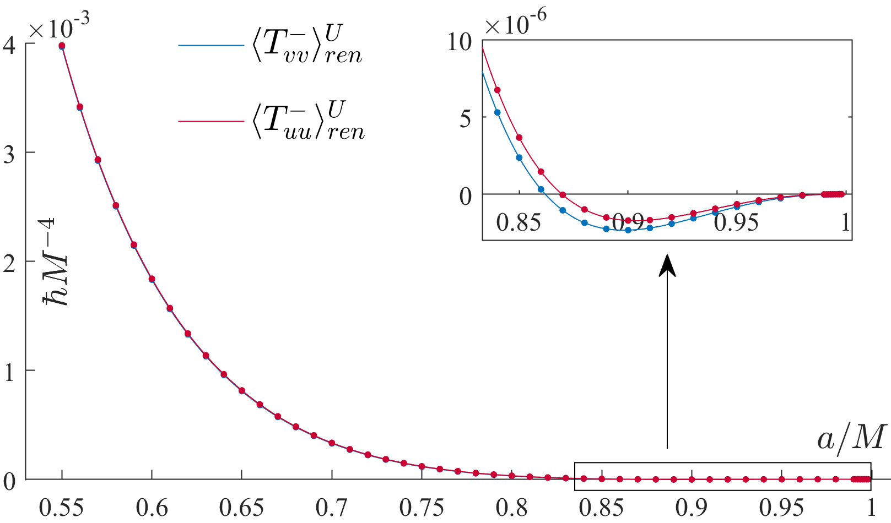
Polar ($θ=0$) IH fluxes vs. BH spin $a/M$
N. Zilberman, M. Casals, A. Ori and A. C. Ottewill (arXiv:2203.08502)
${\left\langle {\hat{T}}_{vv}^{−}\right\rangle }_{ren}^{U}−{\left\langle {\hat{T}}_{uu}^{−}\right\rangle }_{ren}^{U}$ is small
Both change sign
Approach zero as $a/M→1$

Slide 35
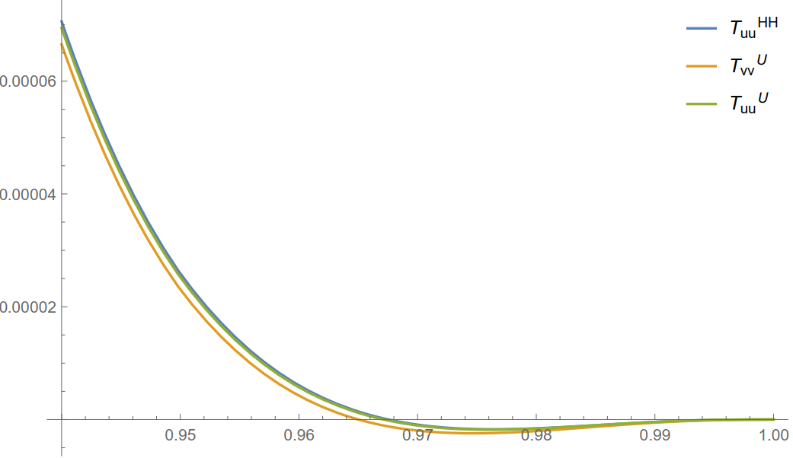
IH Fluxes in the spherical charged case
$$ℏM^{−4}$$
$$T_{uu}^{H}$$
$$T_{vv}^{U}$$
$$T_{uu}^{U}$$
Fluxes vanish when approaching extremality
Fluxes change sign
$$Q/M$$

Slide 36
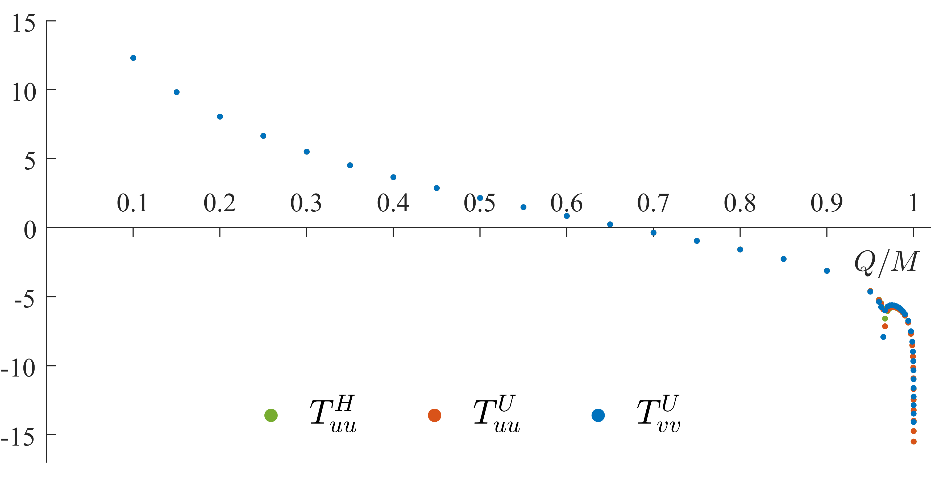
IH fluxes (RN): general $Q/M$ range
$$\log_{10}{|T_{uu}^{H}/ℏM^{−4}|}$$
$$\log_{10}{|T_{vv}^{U}/ℏM^{−4}|}$$
$$\log_{10}{|T_{uu}^{U}/ℏM^{−4}|}$$
N. Zilberman et al. (2019)

Slide 37
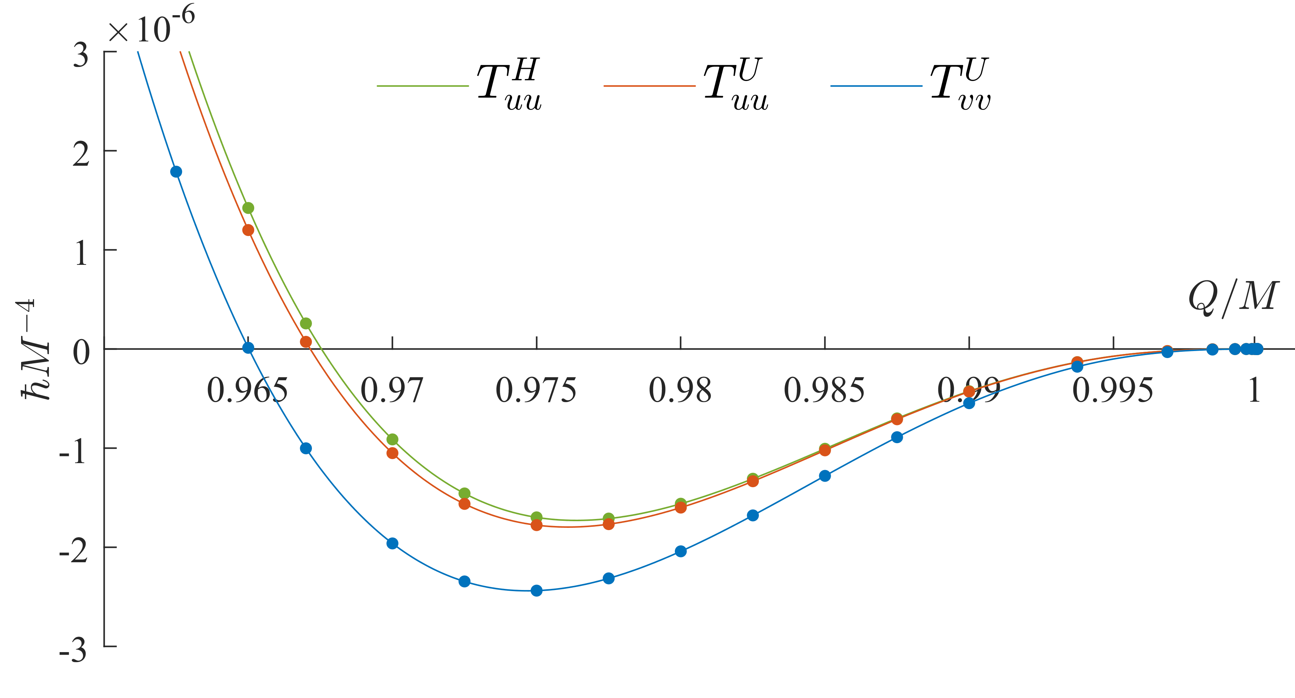
IH fluxes change their sign in the spherical charged case
$q_{vv}^{U}\text{≅}\text{0.965}$, $q_{uu}^{U}\text{≅}\text{0.9671}\text{, }q_{yy}^{H}\text{≅}\text{0.967}\text{5}$
N. Zilberman, A. Levi and A. Ori (Phys. Rev. Lett. 124, 171302, 2020)

Slide 38
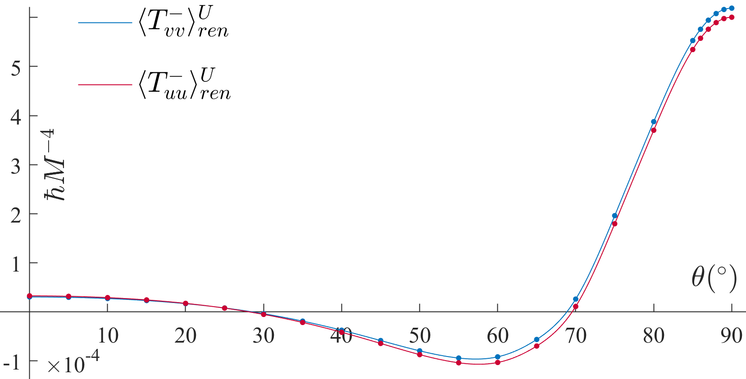
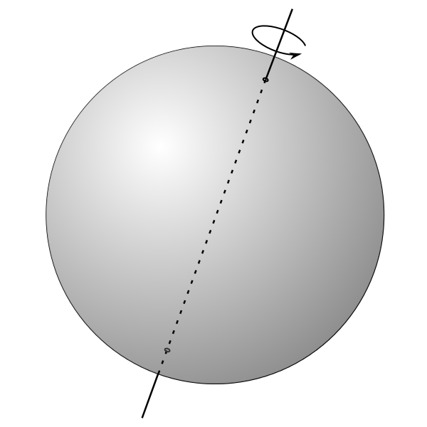
IH fluxes at $a/M=0.8$ vs. polar angle $θ$
N. Zilberman, M. Casals, A. Ori and A. C. Ottewill (arXiv:2203.08502)
$$θ$$
Reminder:
the polar angle $θ$

Slide 39
Our method is new and we used a non-standard quantum state
$→$ crucial to test our method against other methods.
Standard method for regularization in curved spacetime: point-splitting.
We don’t know how to do point-splitting straight at the IH, so we compute the fluxes on approaching $r_{−}$.

Slide 40
Point-splitting fluxes approaching their IH values $$(a/M=0.8, θ=0)$$
IH
$$𝒯_{uu}$$
$$𝒯_{vv}$$
$$δr≡\frac{r−r_{−}}{M}$$

Slide 41
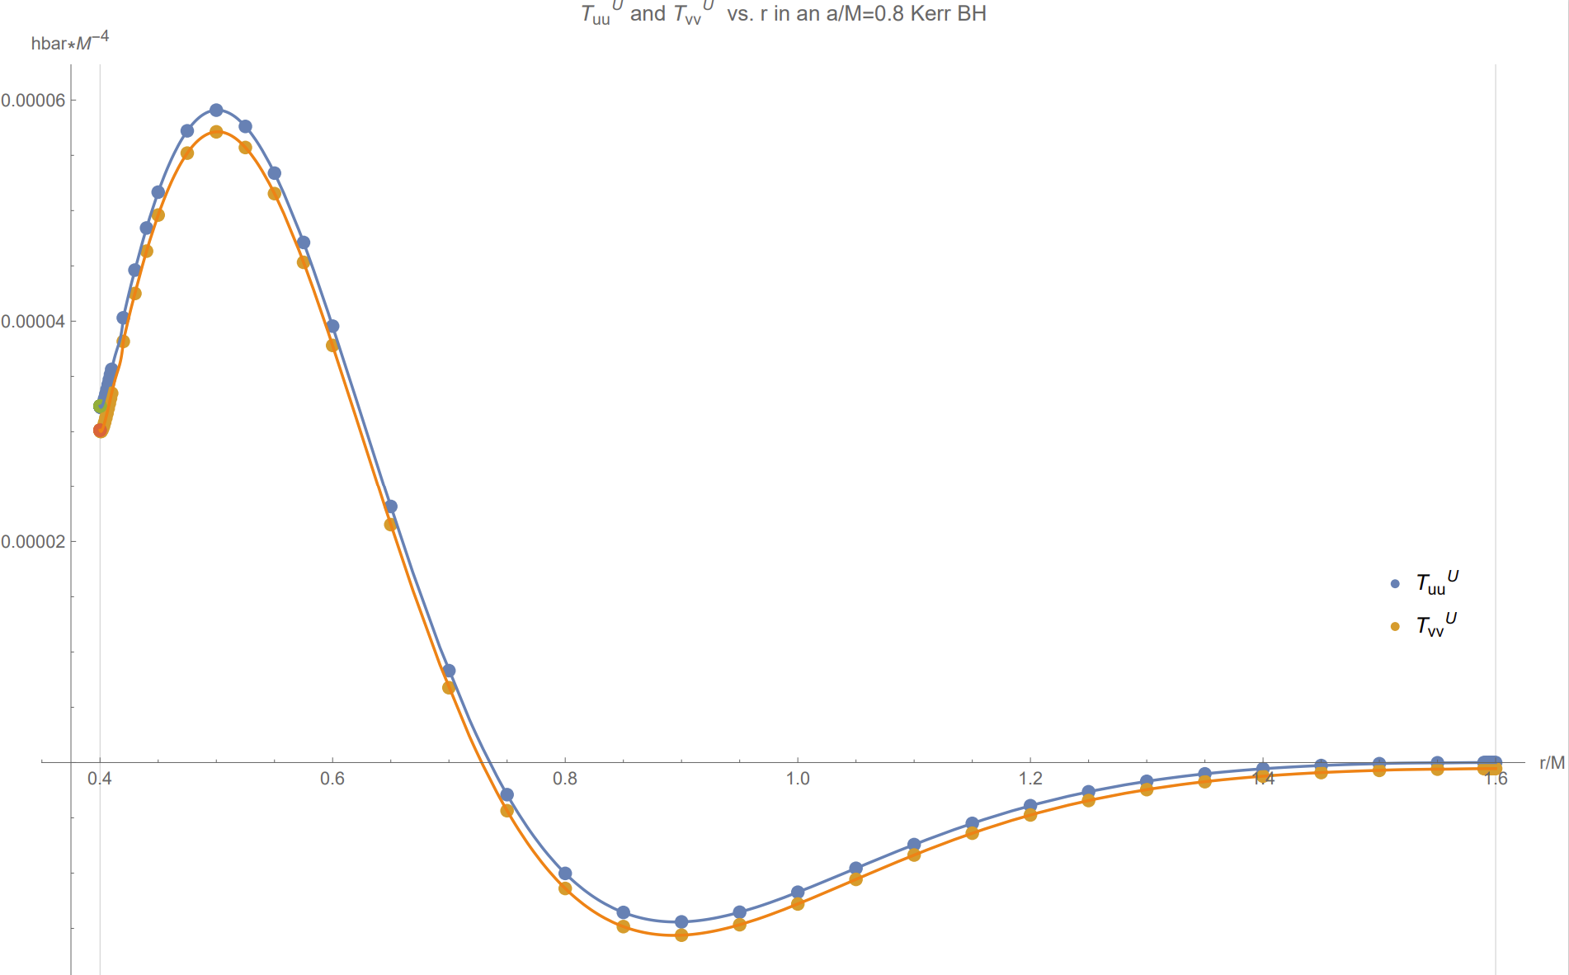
Point-splitting fluxes between the horizons $$(a/M=0.8, θ=0)$$
$$𝒯_{uu}$$
$$𝒯_{vv}$$
$$r/M$$
$$r_{+}/M$$
$$r_{−}/M$$
Time permitting
N. Zilberman, M. Casals, A. Ori and A. C. Ottewill (in preparation)

Slide 42
Polar ($θ=0$) fluxes on approaching extremality
$$ε≡\sqrt{1−{\left(a/M\right)}^{2}}=r_{+}/M−1=1−r_{−}/M$$
Near-extremal case: $ε≪1$
$${\left\langle {\hat{T}}_{vv}^{−}\right\rangle }_{ren}≅−(ℏM^{−4})\frac{1}{7680π^{2}}ε^{4}$$
Analytically and numerically
Numerically
$${\left\langle {\hat{T}}_{uu}^{−}\right\rangle }_{ren}∝(ℏM^{−4})ε^{5}$$
Hawking outflux
per unit solid angle
in the polar direction
$$ℱ\left(θ=0\right)=\left(r^{2}+a^{2}\right)\left(T_{uu}^{U}\left(r\right)−T_{vv}^{U}\left(r\right)\right)≅\left(ℏM^{−2}\right)\frac{1}{3840π^{2}}ε^{4}$$
Time permitting

Slide 43
Near extremality ($a/M→1$, $θ=0)$
N. Zilberman, M. Casals, A. Ori and A. C. Ottewill (arXiv:2203.08502)
Small parameter: $ε≡\sqrt{1−{\left(a/M\right)}^{2}}$
Found analytically
Time permitting

Slide 44
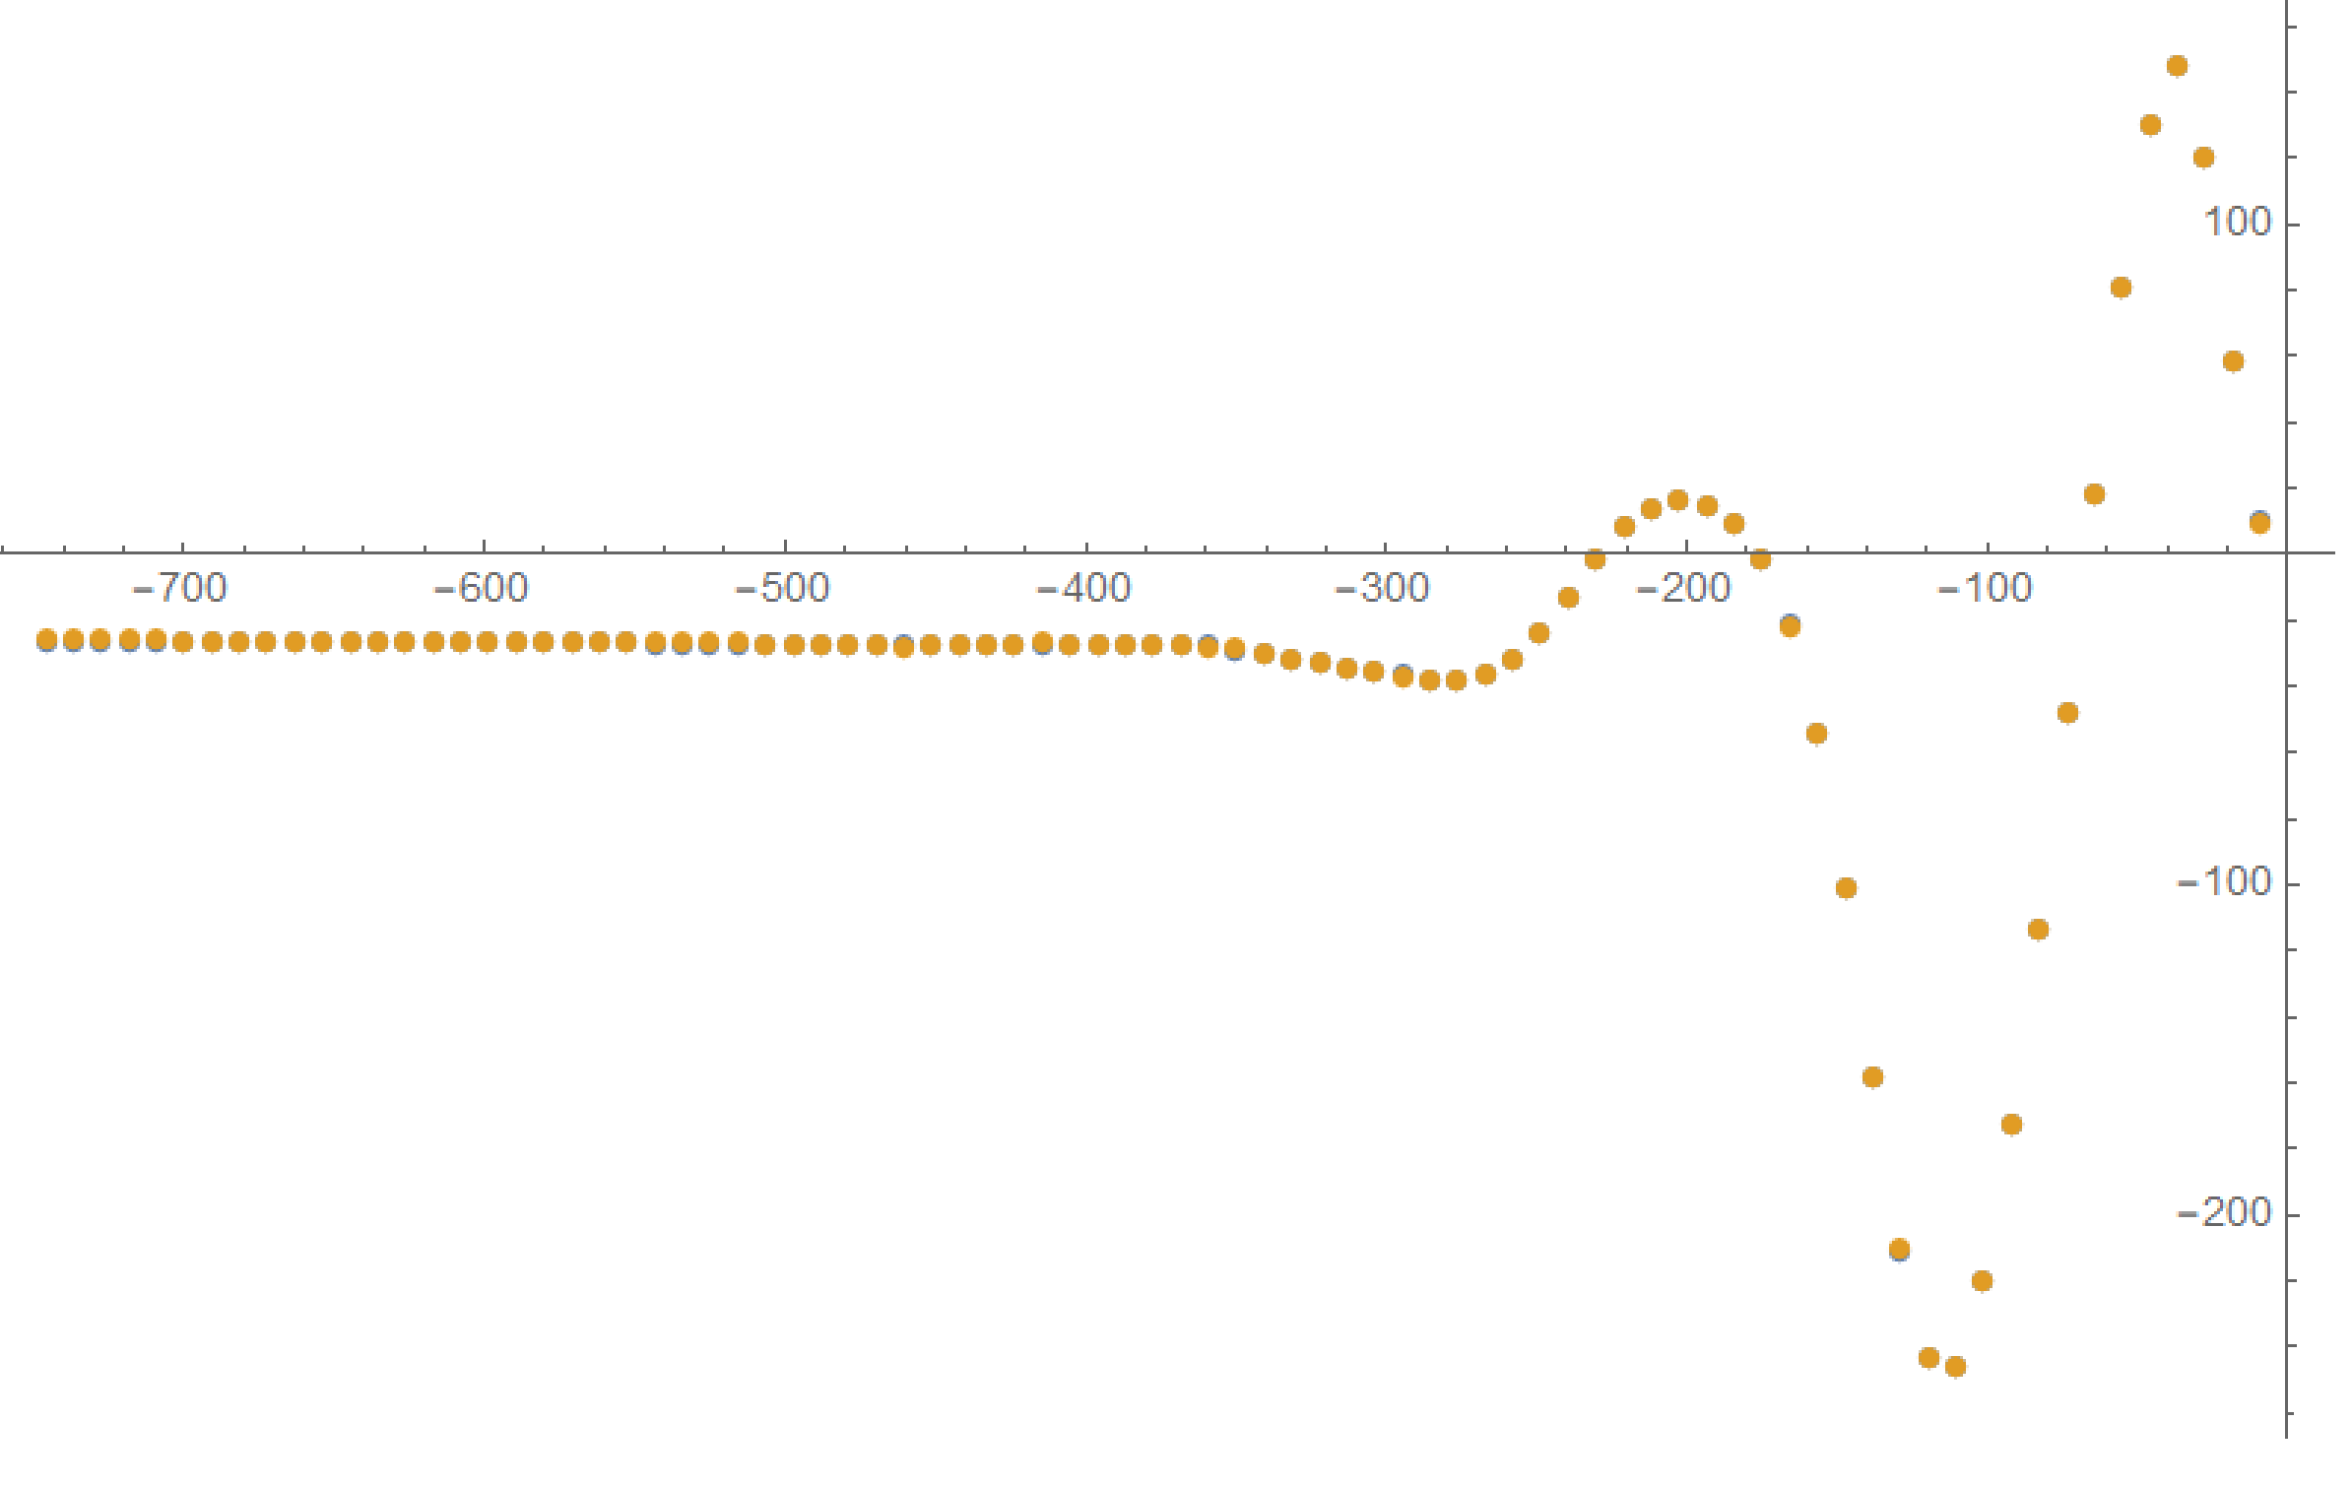
${Δ\left\langle φ^{2}\right\rangle }^{H}⋅{\left(\ln{δr}\right)}^{2}$ vs. $\ln{δr}$ in RN: state-subtraction and $θ$-splitting results Testing our method off the horizon (in RN)

Slide 45
In this talk:
Motivation and basic framework
Unruh quantum state
Mode contributions to the fluxes
Renormalization via state subtraction
Numerical results
Backreaction (preliminary) and summary

Slide 46
(Very) preliminary implications to backreaction
${\left\langle {\hat{T}}_{vv}^{−}\right\rangle }_{ren}≠0$ implies a curvature singularity at the CH:
$${\left\langle {\hat{T}}_{VV}^{−}\right\rangle }_{ren}={\left\langle {\hat{T}}_{vv}^{−}\right\rangle }_{ren}e^{2κ_{−}v}→∞$$
In the spherical charged case: $r_{,y}≅−\frac{4πr_{−}}{κ_{−}}{\left\langle {\hat{T}}_{yy}^{−}\right\rangle }_{ren}$ (in accordance with intuition).
- The sign of ${\left\langle {\hat{T}}_{vv}^{−}\right\rangle }_{ren}^{U}$ - will likely determine the nature of tidal deformation
(an infalling observer undergoes abrupt expansion vs. contraction).
- The sign of ${\left\langle {\hat{T}}_{uu}^{−}\right\rangle }_{ren}^{U}$ - might determine the fate of the CH itself.
Regular Kruskal coordinate:
$$V∝e^{−κ_{−}v}$$
$$dv/dV∝e^{κ_{−}v}$$
$y=u$ or $v$
$$r_{,v}∝−{\left\langle {\hat{T}}_{vv}^{−}\right\rangle }_{ren}$$
IH
CH
Saw in RN
Requires investigation in Kerr
$$r_{,u}∝−{\left\langle {\hat{T}}_{uu}^{−}\right\rangle }_{ren}$$
$$\frac{dr}{dτ}=\frac{dr}{dv}\frac{dv}{dτ}∝−T_{vv}^{−}\frac{dv}{dV}\frac{dV}{dτ}∝−T_{vv}^{−}e^{κ_{−}v}$$
EH
N. Zilberman, A. Levi and A. Ori (Phys. Rev. Lett. 124, 171302, 2020)

Slide 47
Summary
We constructed an unusual quantum state $U$ and used state subtraction for flux regularization and computation in the Unruh state at the IH.
${\left\langle {\hat{T}}_{vv}^{−}\right\rangle }_{ren}^{U}$ and ${\left\langle {\hat{T}}_{uu}^{−}\right\rangle }_{ren}^{U}$: well-defined, generically non-vanishing values.
In particular, this means ${\left\langle {\hat{T}}_{VV}^{−}\right\rangle }_{ren}^{U}$ diverges $→$ curvature singularity.
Sign of the fluxes: depends on $a/M$ and $θ$. The fluxes change sign.
Both fluxes vanish (at different rates) as extremality is approached.
We compared against point-splitting results at the IH and got excellent agreement.

Slide 48
In the future:
Several extensions:
IH-fluxes off-pole at other $a/M$
Fluxes between the horizons (for other $a/M$ and $θ$)
Near-extremal domain (off the pole)
$$a/M$$
$$0.8$$
State subtraction
Point splitting
$$r_{−}$$
$$θ$$
$$0^{∘}$$
$$r$$
More physically realistic
Quantum scalar field $→$ quantum electromagnetic field
Investigate backreaction effects
Is the Cauchy horizon traversable?

Slide 49
Thank you for listening!
Quantum fluxes at the inner horizon of a spinning black hole,
N. Zilberman, M. Casals, A. Ori and A. C. Ottewill (arXiv:2203.08502)
Questions?
noazilber@campus.technion.ac.il

