Slide 1
Perturbations of spinning black holes beyond gr: modified teukolsky equation I
Pratik k. Wagle
With dongjun li, Nicolas Yunes & yanbei chen
Arxiv: 2206.10652
Illinois center for advanced studies of the universe,
Dept. of physics, University of Illinois at Urbana Champaign, USA
23rd international conference on general relativity and gravitation
Beijing China, 5th July 2022

Slide 2
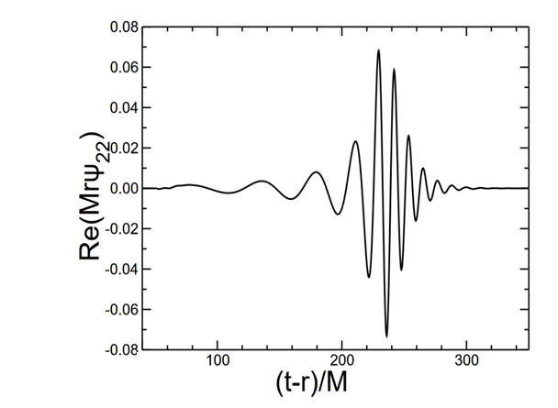
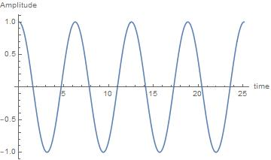
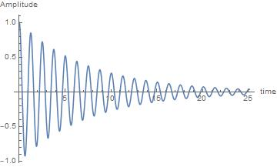
What are QuasiNormal modes (QNM) ?
e.g. Berti+, CQG, 2009
Realistic counterpart of a normal mode
Object of Interest: Black Holes (BH)
Normal mode
Quasinormal mode
Example: Tap a glass with a spoon.
Mathematically,
$$ω_{ℓm}=ω_{ℓm}^{R}+i ω_{ℓm}^{I}$$
Re$\left\{ω_{ℓm}\right\}≔$Oscillation frequency
Im$\left\{ω_{ℓm}\right\}≔$ Damping/Decay

Slide 3
Why study qnms and modified gravity?
BH spectroscopy?
Modified gravity?
Properties of remnant
Modifying Einstein Hilbert action
Kerr hypothesis
Modifications to BH spacetime?
Perturbations to Kerr metric
QNMs encode information about modifications to GR
$=$ constraints?

Slide 4
Perturbed field equations
$$\frac{d^{2}Ψ_{ℓm}^{j}}{dr_{∗}^{2}}+\left(ω^{2} −V^{j}\left(r\right)\right)Ψ_{ℓm}^{j}=0$$
$$\frac{d^{2}Ψ_{ℓm}^{A}}{dr_{∗}^{2}}+\left(ω^{2} −V^{A}\left(r\right)\right)Ψ_{ℓm}^{A}=α k\left(r\right) Ψ_{ℓm}^{S}$$
Issues:
Valid only upto $\frac{a}{M}=0.05$
Separability of angular part
Non-rotating BH in GR
Non-rotating BH in dCS
e.g. C. Molina+, PRD, 2010
Resolution:
NP formalism
Teukolsky approach
Packs all perturbed DOFs into $Ψ_{0}$ and $Ψ_{4}$.
Decoupled and separable equations.
$$Dψ_{j}+V_{j}ψ_{j}=S_{j}[ψ_{k},∂_{r}ψ_{k}]$$
$$\frac{d^{2}Ψ_{ℓm}^{j}}{dr_{∗}^{2}}+\left(ω^{2} −V^{j}\left(r,a\right)\right)Ψ_{ℓm}^{j}=0$$
$$\frac{d^{2}Ψ_{ℓm}^{j}}{dr_{∗}^{2}}+\left(ω^{2} −V^{j}\left(r,a\right)\right)Ψ_{ℓm}^{j}=αS_{j}[ψ_{k},∂_{r}ψ_{k}]$$
Slowly rotating BH in GR
Slowly rotating BH in dCS
e.g. P. Pani+, 2012
e.g. P. Wagle+, 2021
Pratik K. Wagle
4

Slide 5
Newman penrose and teukolsky formalism in gr
Null tetrad: ${(l}^{μ},n^{μ},m^{μ},{\overline{m}}^{μ})$
GR $→$ Petrov type D $→$ $Ψ_{0}=Ψ_{1}=Ψ_{3}=Ψ_{4}=0$
$$R_{μν}=0 →Φ_{ij}=0$$
$$\left(D,Δ,δ,δ^{∗}\right)$$
$$κ=σ=λ=ν=0$$
Orthogonality conditions ✓
36 NP equations,
20 Bianchi identities & 24 commutation relations
$$\hat{F_{1}}Ψ_{0}−\hat{J_{1}}Ψ_{1}−3κΨ_{2}=0$$
$$\hat{F_{2}}Ψ_{0}−\hat{J_{2}}Ψ_{1}−3σΨ_{2}=0$$
$$\hat{E_{2}}σ−\hat{E_{1}}κ−Ψ_{0}=0$$
5 Weyl scalars: $Ψ_{0},Ψ_{1},Ψ_{2},Ψ_{3},Ψ_{4}$
e.g., $Ψ_{0}=C_{αβγδ}l^{α}m^{β}l^{γ}m^{δ}$
$$(\hat{E_{2}^{GR}} \hat{F_{2}}−\hat{E_{1}^{GR}}\hat{F_{1}}−3Ψ_{2})Ψ_{0}=0$$
Teukolsky Equation in GR
Similar equation for $Ψ_{4}$
Decoupled equations for perturbations
Solve for QNMs.
Aim: To get a differential eqn for $Ψ_{0}$
16 Spin coefficients $\left(κ=l_{μ;ν}m^{μ}l^{ν},σ…\right)$
Bianchi identities $→DΨ_{2}=3ρΨ_{2} , δΨ_{2}=3τΨ_{2}$
Tetrad rotations
Commutator relation:$\hat{E_{2}^{GR} }\hat{J_{2}}−\hat{E_{1}^{GR} }\hat{J_{1}}=0$
$$key:$$
$−$ perturbed

Slide 6
Extending teukolsky formalism to non-gr Non-Ricci-flat type d spacetimes
Non- GR non-Ricci-flat Petrov type D $→$ dynamical Chern Simon or Einstein dilaton Gauss Bonnet gravity to $O(χ)$
Non-GR $→$ Petrov type D $→$ $Ψ_{0}=Ψ_{1}=Ψ_{3}=Ψ_{4}=0$
$$R_{μν}≠0 →Φ_{ij}≠0$$
Previous three eqns with non-zero source
$$κ≠σ≠λ≠ν≠0$$
NP eqn & Bianchi identity
$$\hat{F_{1}}Ψ_{0}−\hat{J_{1}}Ψ_{1}−3κΨ_{2}=S_{1}$$
$$\hat{F_{2}}Ψ_{0}−\hat{J_{2}}Ψ_{1}−3σΨ_{2}=S_{2}$$
$$\hat{E_{2}}σ−\hat{E_{1}}κ−Ψ_{0}=0$$
Commutator relation: $\left(\hat{ℰ_{2} }\hat{J_{2}}−\hat{ℰ_{1} }\hat{J_{1}}\right)Ψ_{1}$
$$=0$$
GR value
Leading order in $(ζ,ε)$
$$Ψ_{1}=Ψ_{1}^{(0,0)}+{ζΨ}_{1}^{(1,0)}+εΨ_{1}^{(0,1)}+{ζεΨ}_{1}^{(1,1)}$$
The new master equation
$$(\hat{ℰ_{2}} \hat{F_{2}}−\hat{ℰ_{1}}\hat{F_{1}}−3Ψ_{2}) Ψ_{0}=\hat{𝒮 }$$
$$\hat{𝒮}=\hat{ℰ_{2}}S_{2}−\hat{ℰ_{1}}S_{1}+\hat{ℰ_{2}}S_{2}−\hat{ℰ_{1}}S_{1}$$

Slide 7
Probing the meaning of the modified teukolsky equation
The new master equation
$\hat{ℰ_{2}}=D−ρ−ρ^{∗}−3ε+ε^{∗}−\frac{1}{Ψ_{2}}DΨ_{2}$ ; $\hat{F_{2}}=Δ−4γ+μ$
$\hat{ℰ_{1}}=δ−τ+π^{∗}−α^{∗}−3β−\frac{1}{Ψ_{2}}δΨ_{2}$ ; $\hat{F_{1}}=δ^{∗}−4α+π$
$$(\hat{ℰ_{2}} \hat{F_{2}}−\hat{ℰ_{1}}\hat{F_{1}}−3Ψ_{2}) Ψ_{0}=\hat{𝒮 }$$
Toy Model: dCS
Curvature scalar field $θ$
$O(ζ,χ,ε)$
$$\left\{S_{1},S_{2}\right\}=χ ζ f(θ,θ,NP,NP)$$
Can be calculated from $h_{μν}^{GW}$
Calculated from background tetrad
e.g., Kinnersly tetrad
coupling
perturbation
spin
Master equation
coupled
Implement background tetrad for dCS
Implement perturbation to tetrad
Decouple
$r$ & $θ$
$$+$$
Solve for QNMs
To all orders in spin?
Extension to type 1 spacetimes
Petrov type I
$$Ψ_{0}=0=Ψ_{4}$$
Check the next talk!
Thank you!!!

