Slide 1
Thermodynamics in Quartic Generalized Quasi-topological Gravity (GQG)
Mengqi Lu, Physics & Astronomy

Slide 2
Higher-curvature Theories of Gravity
Action:
Some higher-curvature invariants:

Slide 3
Why Higher-curvature Theories of Gravity
Higher-curvature theories of gravity are extensions of General Relativity (GR) that arise in effective descriptions of quantum gravity theories, such as String Theory.
Higher-curvature theories of gravity can be free of instabilities and ghosts at the linear level, and whose equations of motion for static, spherically symmetric spaces acquire a sufficiently simple form so as to allow for the non-perturbative study of black hole solutions.

Slide 4
Higher-curvature Theories of Gravity: Definitions
Lovelock Gravity
Field equation for the metric is second order.
Their field equation for a SSS metric only differ by an overall factor.
Quasi-topological Gravity(QG)
Field equation for a static spherically symmetric (SSS) metric is algebraic.
GQG
Field equation for the metric is fourth order, but reduces to second order for a SSS metric.
True GQG
Field equation for a SSS is non-algebraic

Slide 5
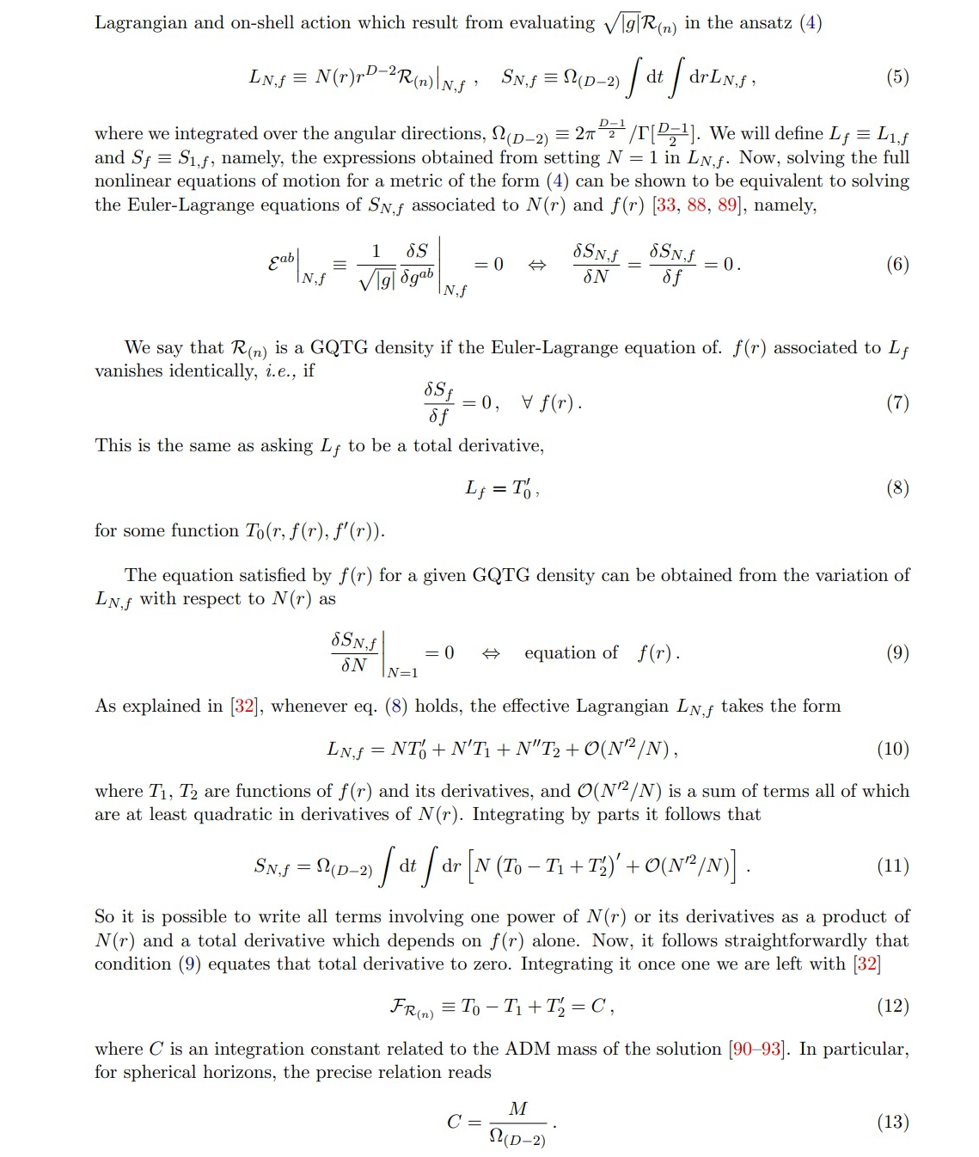
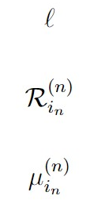
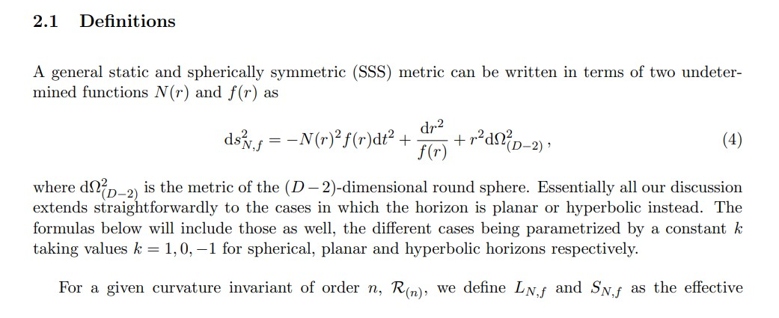
Construction of GQGs
is some length scale
are GQG densities of order n
are GQG couplings
Source: 2203.05589.pdf (arxiv.org)

Slide 6
How Many Inequivalent GQGs
Inequivalence: we say that two GQG densities of a fixed curvature order n are inequivalent if they give rise to different equations for the SSS metric function f(r).
If d>4, there are n-2 inequivalent true GQG densities and 1 unique QG density at order n. (has been proven in 2203.05589.pdf (arxiv.org))
If d=4, there is likely only one true GQG density at each order n>3 and no QG density. (hasn’t been proven)

Slide 7
Previous and Current Work on GQGs (not QG)
The cubic GQG (only one) is studied in *JHEP08(2019)068.pdf (springer.com)
One of the quartic GQG is studied in *JHEP07(2019)012.pdf (springer.com)
The other one quartic GQG is recently found and constructed in 2203.05589.pdf (arxiv.org)

Slide 8
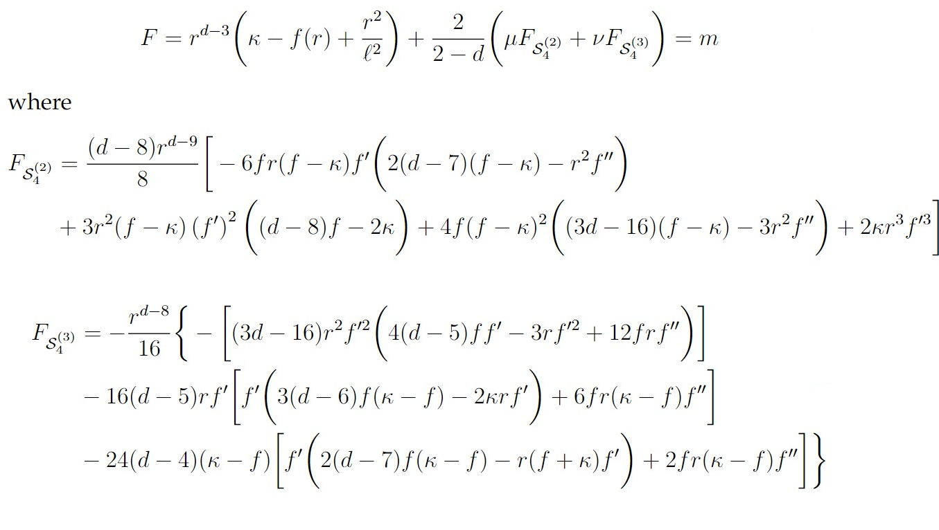
Quartic GQGs
The quartic QGQ densities are explicitly constructed in 2203.05589.pdf.
The equation of motion including two inequivalent pure quartic GQGs for the SSS metric f(r) can be derived from Euler-Lagrangian equation. m is related to mass here.

Slide 9
Solving Field Equation: Trivial Solution
Since is quasi-topological in d=8, it doesn’t contribute to the equation of motion. If ν vanishes, then no matter what value μ takes, the following is the exact solution for the metric.

Slide 10
Solving Field Equation: Degenerate Vacuum Solution
Consider a maximally symmetric AdS Space whose metric takes the form
where is defined by
Doubly degenerated when

Slide 11
Solving Field Equation: Far Region Solution
Consider an asymptotic expansion
For non-vanishing h’, insert the expansion into the field equation and get

Slide 12
Solving Field Equation: Far Region Solution
For vanishing h’, we have
Degenerate (multiple) solutions of vanishing h’ will yield weaker falloff behaviour for nonzero mass.
If d=8, A vanishes. No degeneracy happens in 8 dimensions.

Slide 13
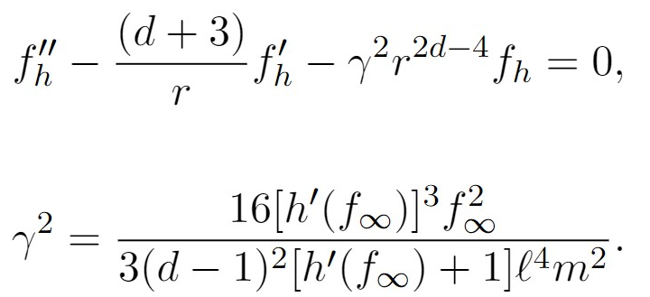
Solving Field Equation: Far Region Solution
By inserting into the field equation, we get the homogeneous solution in the far region
If is non-zero, the homogeneous equation is
If vanishes, we have , and the homogeneous equation is

Slide 14
Solving Field Equation: Far Region Solution
The solutions to these homogenous equations are Bessel functions.
If γ^2 >0 and is non-zer0, we have
If γ^2 >0 and is zer0, we have
For the correct asymptotic AdS behavior, in either case, we require A to be zero.

Slide 15
Solving Field Equation: Far Region Solution
The solutions to these homogenous equations are Bessel functions.
If γ^2 <0 and is non-zer0, we have
If γ^2 <0 and is zer0, we have
For the correct asymptotic AdS behavior, in either case, we require both A and B to be zero. However, negative γ^2 still make the solution problematic. Therefore, in order to construct asymptotic AdS solutions, γ^2 must be positive.

Slide 16
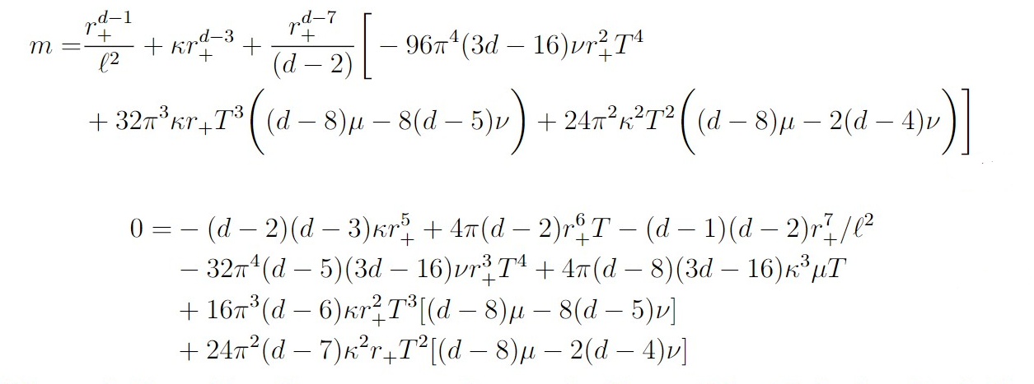
Solving Field Equation: Near Horizon Solution
Consider the near horizon expansion
T is the Hawking temperature of the black hole. It is found by imposing the regularity condition for the Euclidean sector of the complex manifold.
Inserting the near horizon expansion into the field equation and imposing that it holds at each order of (r-r+) we obtain for the zeroth and the first order terms.

Slide 17
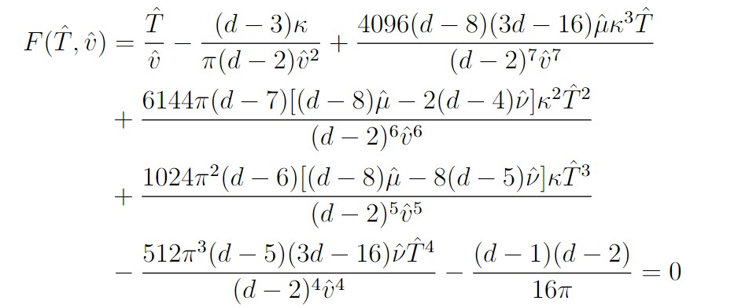
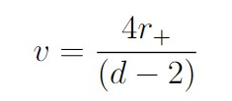
Thermodynamical Variables
The zeroth and the first order terms obtained from near horizon expansion can be rescaled to
where

Slide 18
Physical Constraints
Generalized quasi-topological theories have the property that only the massless graviton propagates on constant curvature backgrounds provided the parameters are appropriately constrained. To ensure this, the effective Newton constant of gravity must have the same sign as that in Einstein gravity. This implies that the pre-factor in the linearized equations of motion about the AdS solution is positive.
Then h’<0, that is
As discussed previously, γ^2 >0, that is

Slide 19
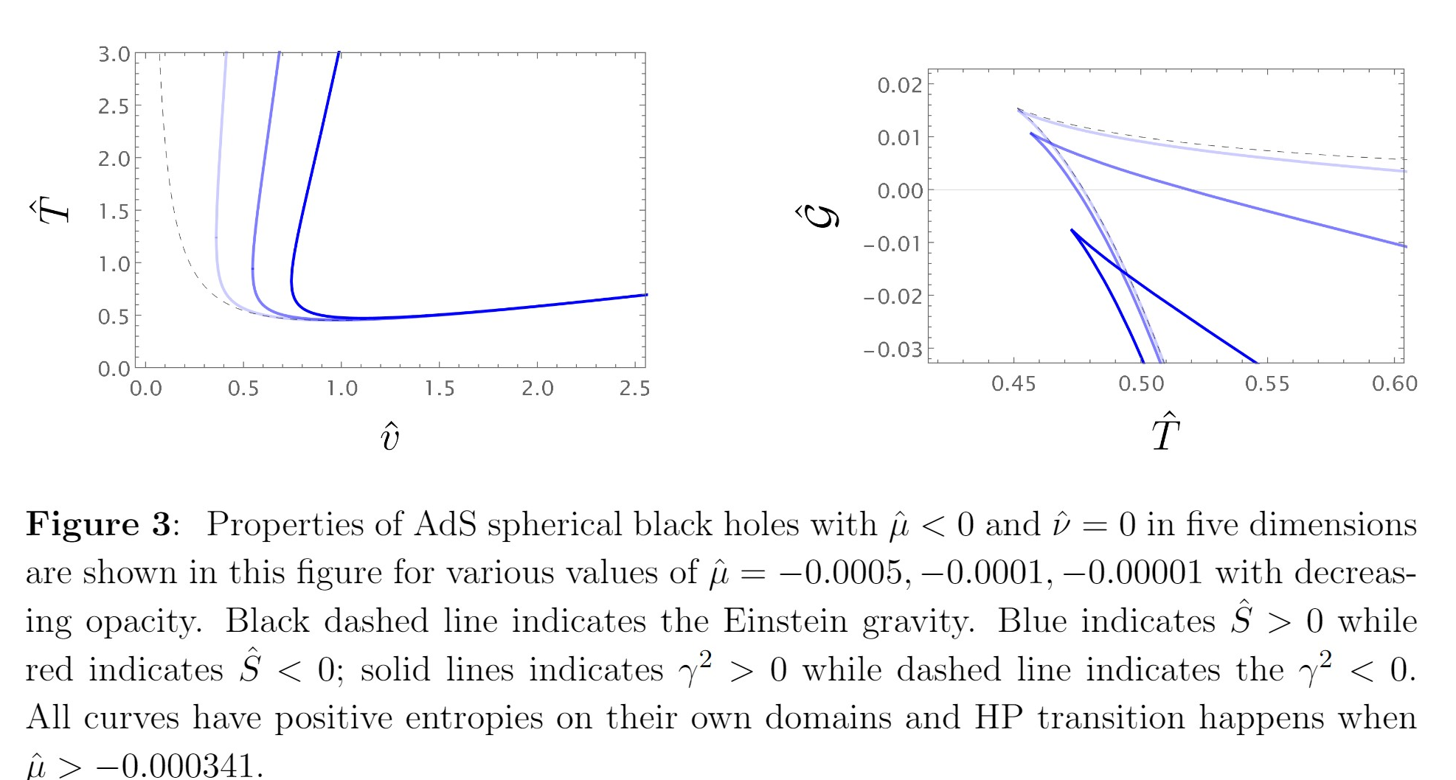
Temperature-horizon Relations for Ads spherical black holes: d=5

Slide 20
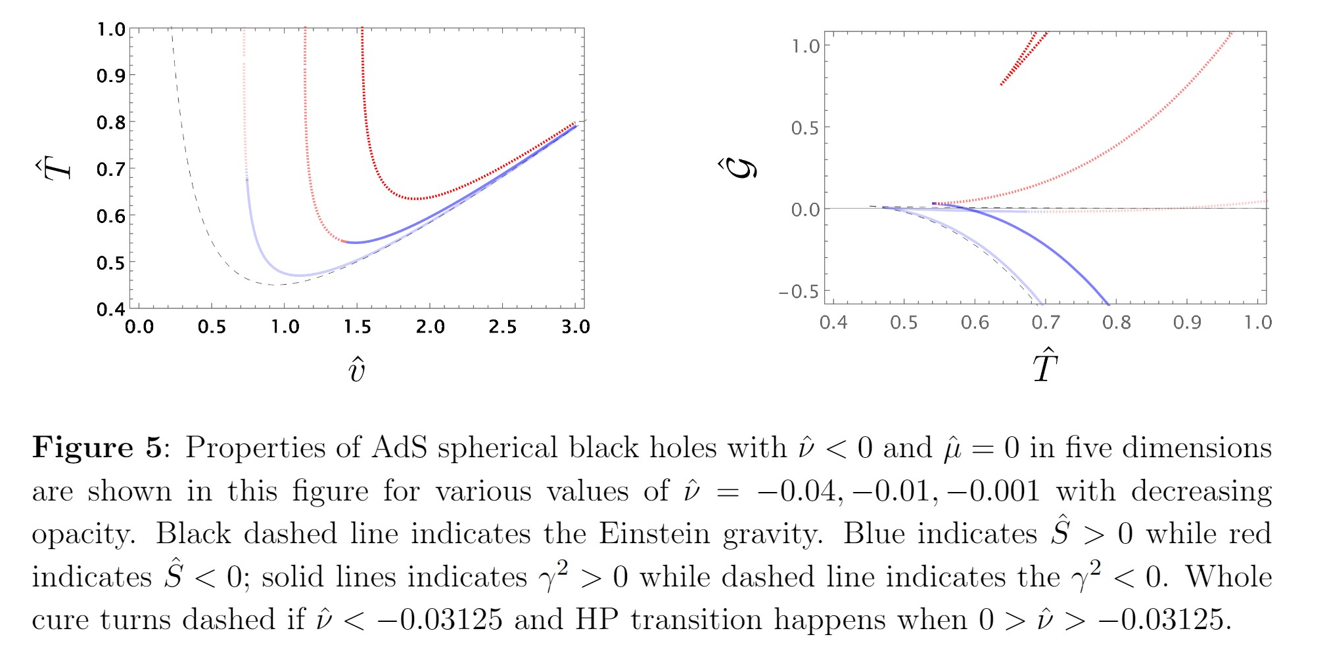
Temperature-horizon Relations for Ads spherical black holes: d=5

Slide 21
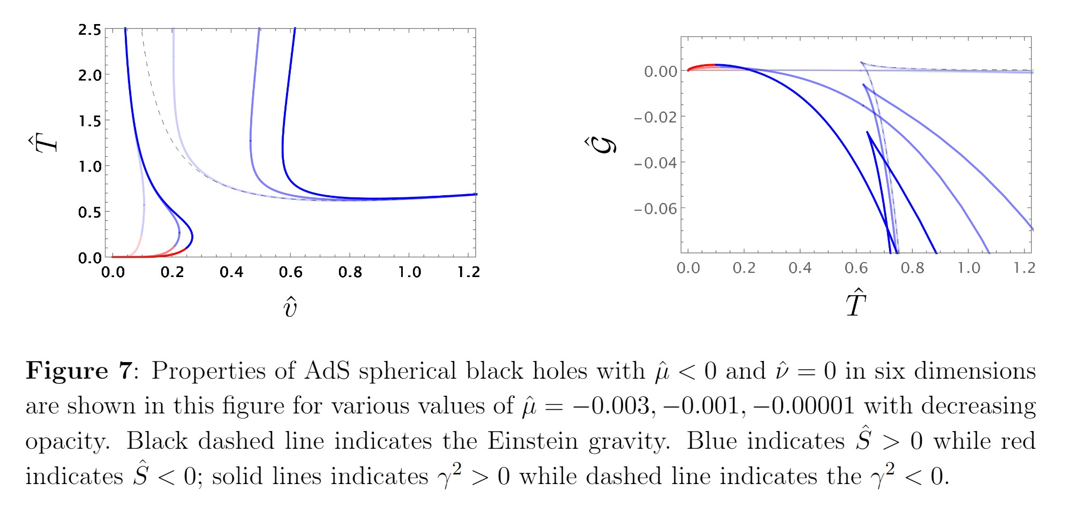
Temperature-horizon Relations for Ads spherical black holes: d=6

Slide 22
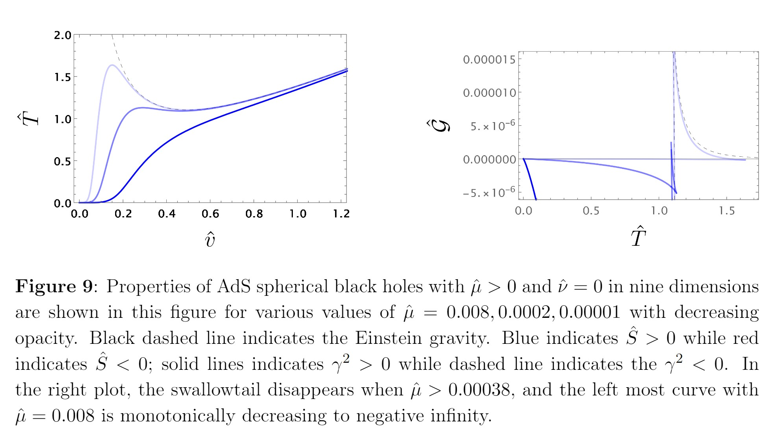
Temperature-horizon Relations for Ads spherical black holes: d=9

